Slide 1
2019 New Jersey Student Learning Assessment (NJSLA)
District Technology Coordinator Training
PearsonAccess^{next} & NJSLA Technology Requirements
February 2019
Orlando Vadel – John Boczany – Tim Steele-Dadzie
New Jersey Department of Education Office of Assessments
With Matt Carlson and Michael Biederman
Pearson

Slide 2
Agenda
Part I: Before Testing - Technology Coordinator Preparation | Technology System Requirements Technology Setup
Part II: Before Testing - Test Coordinator Preparation | What’s new this year? PearsonAccess^{next} Student Readiness Infrastructure Trial
Part III: During Testing | Session Management Technical Troubleshooting
Part IV: After Testing | Session Clean-Up Resolve Critical Warnings Purge Test Content
Part V: Additional Information | Paper Materials Resources & Support

Slide 3
Glossary and Important Terminology
DTC – District Test Coordinator
OS – Operating System
PearsonAccess^{next} (PAN) – Serves as the entry point to all Pearson services used by school districts participating in the New Jersey assessment. It is the web-based technology platform for end-to-end administration of the New Jersey assessments. PearsonAccess^{next} technology integrates multiple products and services to configure a comprehensive assessment solution.
ProctorCache – Downloading encrypted test content from the Pearson server to a secure local computer prior to starting a test session.
Infrastructure Trial – The purpose is to confirm TestNav is configured correctly, devices can successfully run TestNav, the network will support the full load, participating staff know what to do for NJ computer-based assessments, and students are familiar with the computer-based testing tools and format.
SR/PNP – Student Registration/Personal Needs Profile
STC – School Test Coordinator
TA – Test Administrator
TestNav – Pearson’s comprehensive assessment solution that includes the online test delivery platform.

Slide 4
Part I: Before Testing – Technology Coordinator Preparation
Resources:
Technology System Requirements
Technology Setup
  Configure the Network
  Install ProctorCache
  Precache Test Content & TestNav Configurations in PearsonAccess^{next}
  Setup Secondary Save Locations

Slide 5
Resources – Manuals for Technology Coordinators
https://nj.mypearsonsupport.com/
  Hardware and Software System Requirements
  Infrastructure Trial Guide
  Browser and App Setup Guides
  Proctor Caching Installer and Guide
  TestNav 8 User Guide
  PearsonAccess^{next} Online User Guide

Slide 6
Resources – Training Modules for Technology Coordinators
https://nj.mypearsonsupport.com/
  Proctor Caching and TestNav Configuration
  Infrastructure Trial

Slide 7
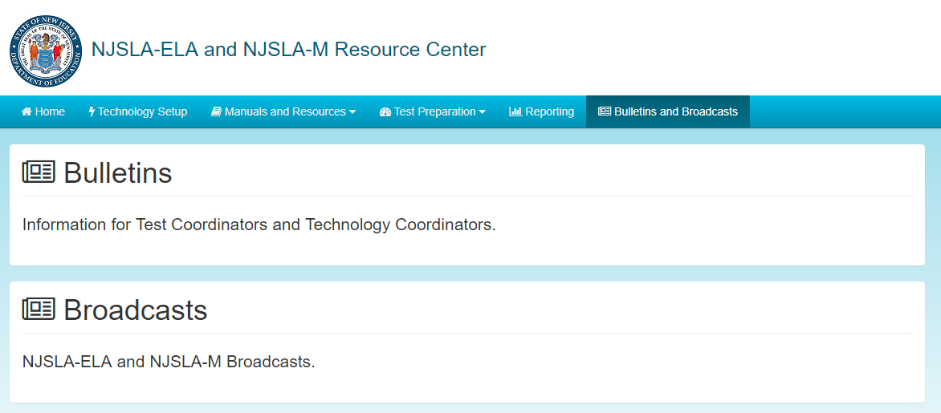
Resources – Bulletins
https://nj.mypearsonsupport.com/

Slide 8
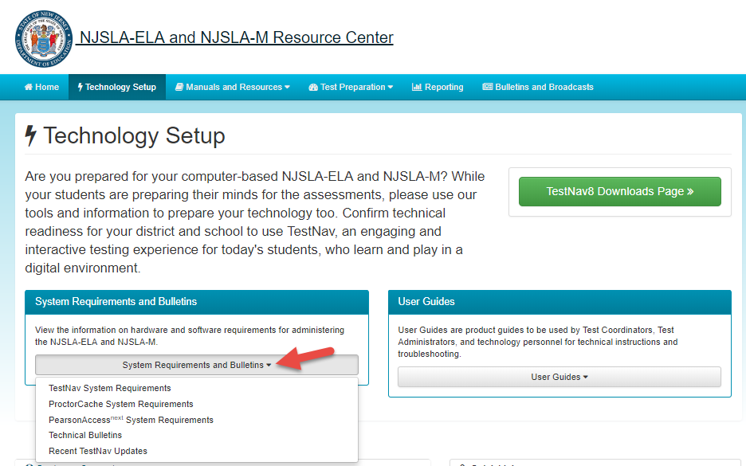
Technology System Requirements
https://nj.mypearsonsupport.com/

Slide 9
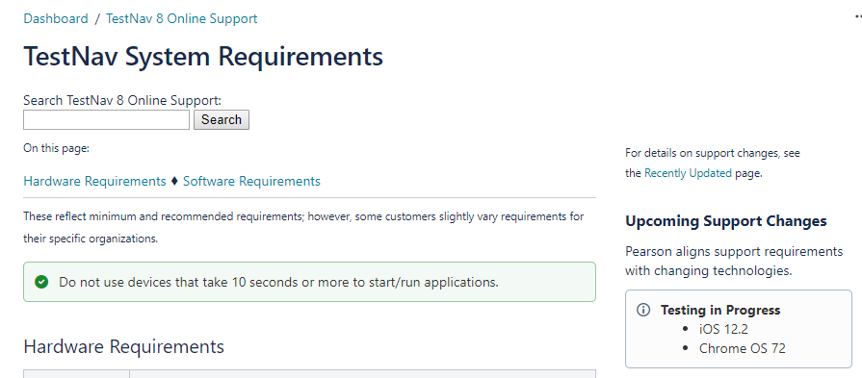
TestNav App Requirements
https://support.assessment.pearson.com/x/HwYcAQ

Slide 10
What’s New This Year?
TestNav 8 Updates
  Browser-based TestNav is no longer supported using the Firefox ESR – was previously supported but Mozilla ended support of required plugins.
  The app will support most Assistive Technologies – an infrastructure trial is recommended to confirm functionality. Co:Writer and Read&Write will require use on a 3rd party device with transcription.
  Versions 1.7.3 for TestNav Applications
  Version 2018.11 for Proctor Caching (Windows OS).

Slide 11
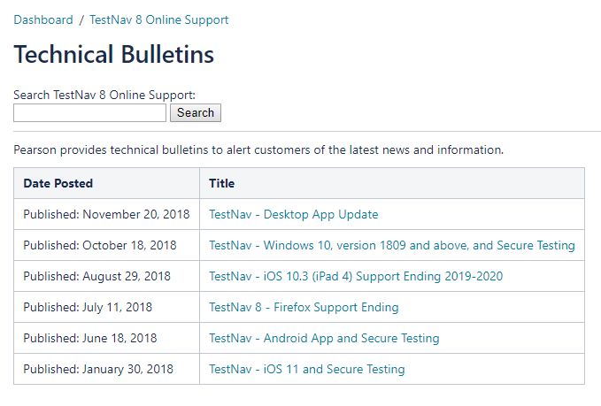
Changes to Technology Requirements (1 of 3)
  Tech Bulletins - https://support.assessment.pearson.com/x/IwACAQ

Slide 12
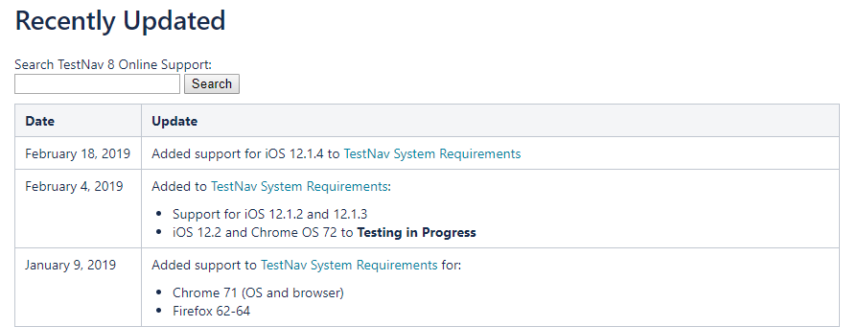
Changes to Technology Requirements (2 of 3)
Recent updates-https://support.assessment.pearson.com/x/SAMcAQ

Slide 13
Changes to Technology Requirements (3 of 3)
Browser-based TestNav is no longer supported using the Firefox ESR – was previously supported but Mozilla ended support of required plugins.
The app will support most Assistive Technologies – an infrastructure trial is recommended to confirm functionality. Co:Writer and Read&Write will require use on a 3rd party device with transcription.

Slide 14
iOS: Automatic Assessment Configuration
Steps required when students are testing with iPads:
  Allow Microphone (one-time prompt)
  Allow App Self-Lock prompt
    Guided Access Mode or managing device security via an MDM are no longer used for TestNav. Using either of these processes will prevent students from accessing their tests.
    When signing into the test, students will be prompted to lock down the device. Once they click “Yes” the device will be locked down until they either submit their test or log out.
      If a student clicks “No” they will need to sign in again

Slide 15
TestNav Desktop
The TestNav Desktop App
  Available at http://download.testnav.com/
  Runs on specific versions of Windows, Android, Chrome OS, iOS, mac OS , macOS Sierra and Linux Operating Systems
      For specific Operating System versions, please review: TestNav System Requirements
  No Java dependencies
  No Pop-Up Blocker settings required
  Identical student login experience on Chromebooks and iPads
  Compatible with touchscreen devices
Additional Notes
  The TestNav Desktop App is now compatible with Assistive Technology (AT)
    Browser-based testing is no longer required for use with AT
    Always test for AT compatibility by completing an Infrastructure Trial
    Review NJSLA Assistive Technologies Guidelines (Available in March)

Slide 16
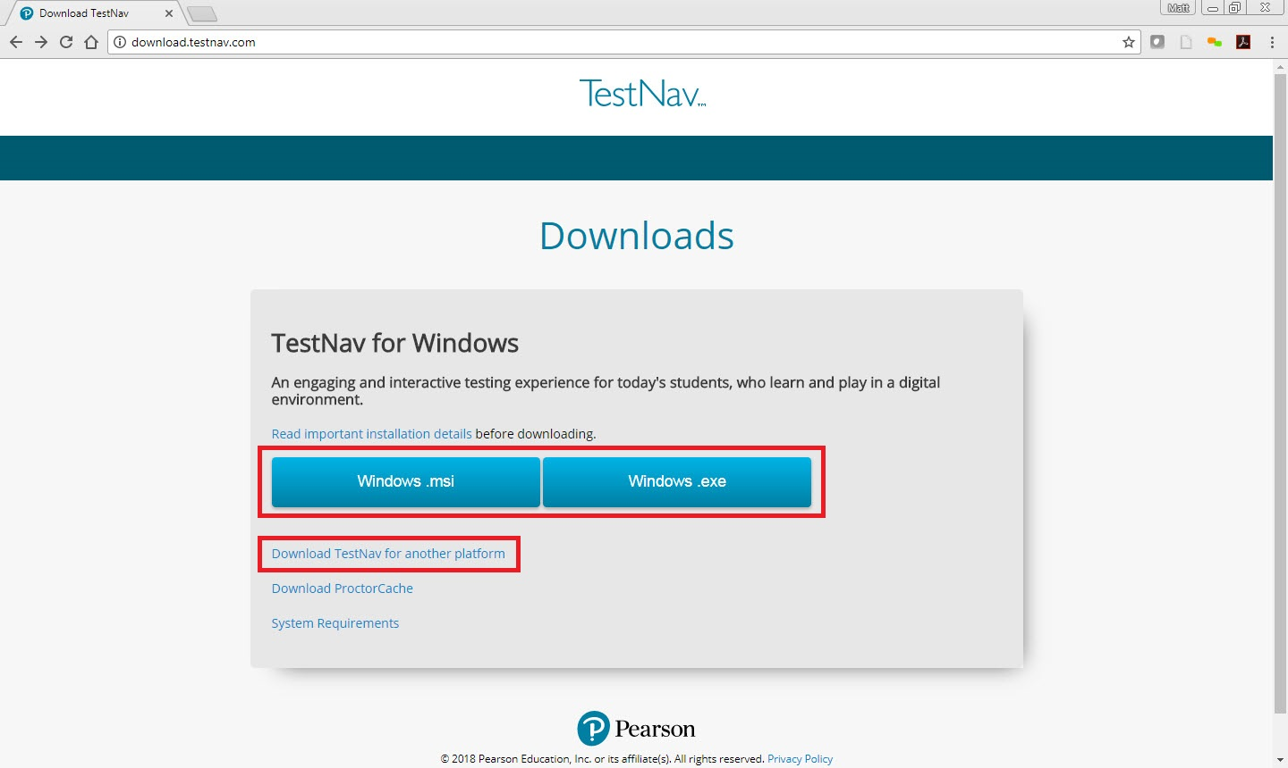
TestNav Downloads Page
http://download.testnav.com/

Slide 17
Technology Setup
Technology Setup
    Configure the Network
    Proctor Caching
    TestNav 8 and Proctor Caching Configurations
    Practice Tests and Tutorials

Slide 18
Configure the Network
TestNav 8 Domains and Ports:
  *.testnav.com:80, 443
  *.pearsontestcontent.com
  *.thawte.com
  *.usertrust.com
  *.comodoca.com
  *.google-analytics.com (Optional)
Pre-caching Local Network Ports:
  4480, 4481
PearsonAccess^{next} Domain and Ports:
  *.pearsonaccessnext.com:80, 443
PearsonAccess^{next} emails:
  @support.pearson.com

Slide 19
Proctor Caching for TestNav Introduction
Proctor Caching is Pearson-supplied software that is used in conjunction with TestNav to reduce bandwidth requirements and accelerate the delivery of test content.
Proctor Caching:
  Allows you to precache test content to your local network before a test
  Reduces the burden on your Internet Service Provider (ISP) by eliminating redundancy in requests for test content
  Stores an encrypted local copy of all precached tests

Slide 20
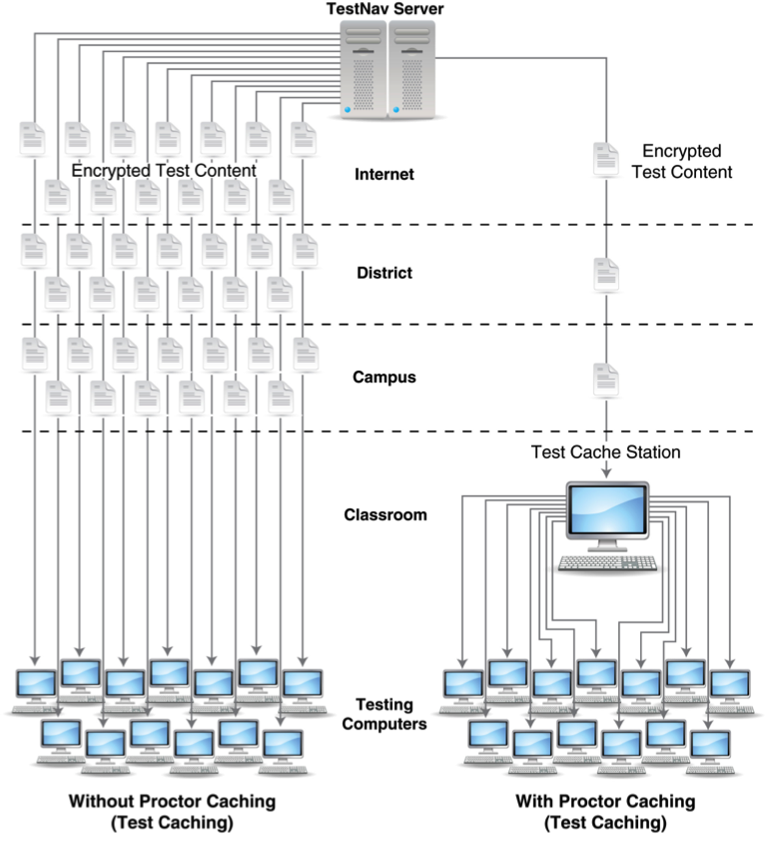
Proctor Caching – The Network

Slide 21
Proctor Caching Requirements
Proctor Caching runs on Windows and Mac OS X
It does not require an underlying server-based operating system
Proctor Caching hardware requirements can be found at https://support.assessment.pearson.com/x/PQACAQ
TCP Ports include: 80 (Internet), 4480, and 4481 (Local Network).
Proctor Caching requires a fixed (static) internal IP address
Utilize the App Check feature within the TestNav Apps to verify connection to the ProctorCache device.

Slide 22
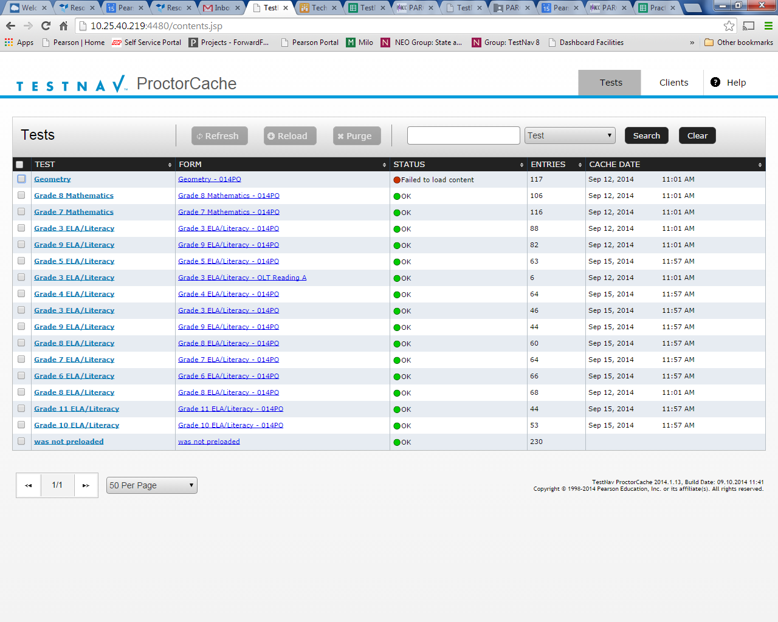
What’s New for ProctorCache
All new Proctor Caching configurations will have the Precaching Computer Override option selected. When this option is selected, all TestNav clients will bypass the ProctorCache machine that is unavailable and send all traffic out to the Internet (WAN) until the student logs out of the test unit.
It is recommended to upgrade to the latest version of the ProctorCache software. The most recent version of ProctorCache is 2018.11 and can be dowloaded available via download.testnav.com.
For Mac OS, you can still use the previously installed ProctorCache software. If you need to download this version of the ProctorCache software that works on a MacOS device, please contact Pearson Customer Support. When using ProctorCache software on MacOS users may see a message stating “This app needs to be updated by its developer to improve compatibility”, which can be ignored.

Slide 23
Proctor Caching Setup
Download the Proctor Caching installer
Run the installer and Start the Proctor Caching Service if it is not already started by the installer
Add a Proctor Caching computer to the TestNav Configuration within PearsonAccess^{next} at the district or school level
Use App Check with a Configuration Identifier from the TestNav Configuration in PearsonAccess^{next} on a client computer to verify that Proctor Caching is functional
Note: To configure an upstream proxy, refer to the Windows or Mac “Upstream Proxy Configuration” section in the Proctor Caching User Guide located here: https://support.assessment.pearson.com/x/HAACAQ.

Slide 24
Demonstration
Download & Install ProctorCache
Setup TestNav Configuration in PearsonAccess^{next}
TestNav App Check
Precache Test Content

Slide 25
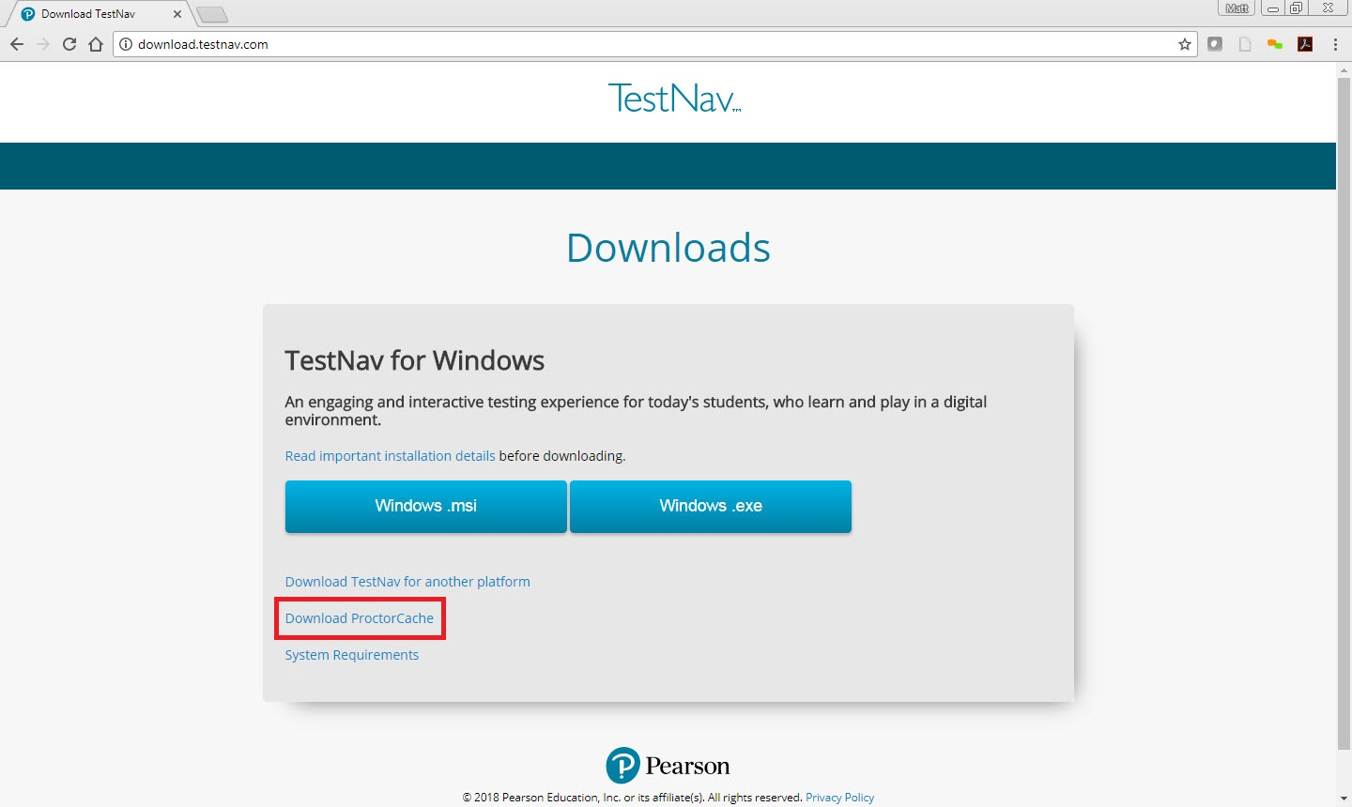
Download & Install ProctorCache
http://download.testnav.com/

Slide 26
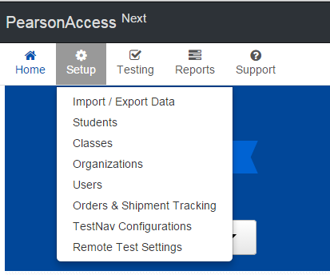
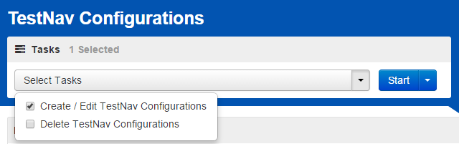
Prepare TestNav Configuration
Sign in to the New Jersey PearsonAccess^{next} Training Center or the New Jersey PearsonAccess^{next} website.
  Make sure you are working under the New Jersey Account Scope as TestNav Configurations are Account Scope Specific.
Once you have selected the correct administration in the top right drop-down menu, Select Setup > TestNav Configurations.
Select Create/Edit Configurations;
click Start to launch the configuration.

Slide 27
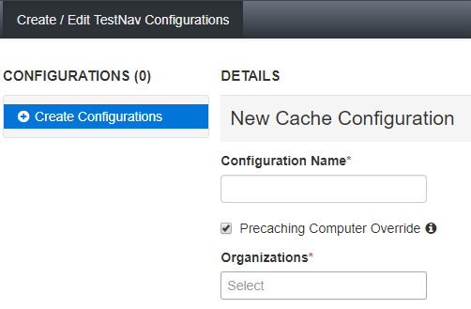
Prepare TestNav Configuration
Enter a Configuration Name.
Using the Organizations dropdown menu, select your school or district.

Slide 28
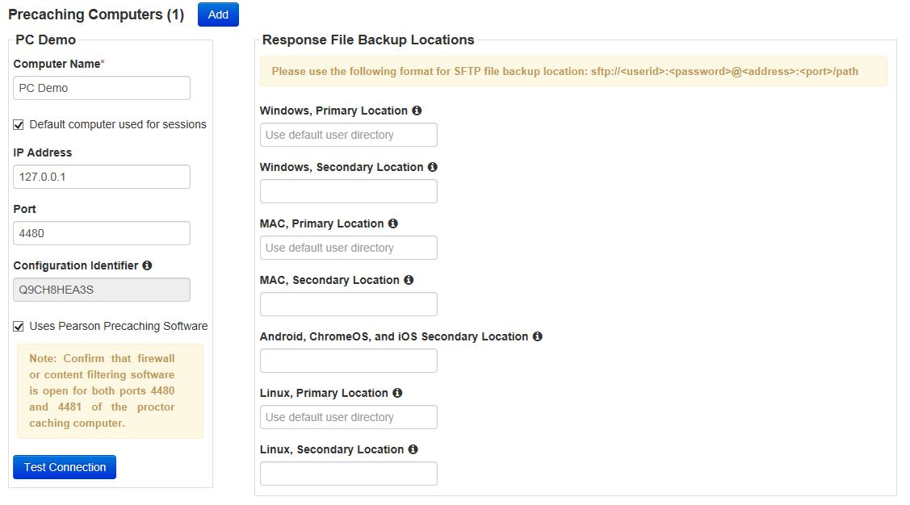
Prepare TestNav Configuration
Enter the Computer Name, IP Address, and Port, and check “Uses Pearson Precaching Software.”
Then specify student response file backup locations, and click Create.

Slide 29
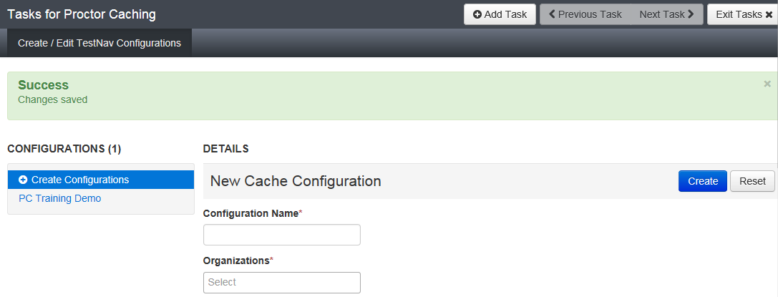
Completed TestNav Configuration(s)

Slide 30
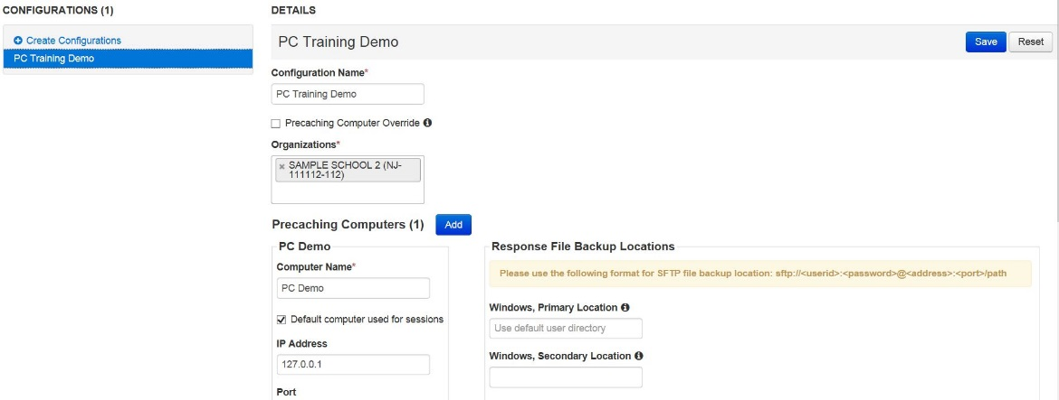
TestNav Configuration Details
Configuration Details allows you to:
  edit the configuration name,
  add additional organizations to the configuration,
  edit settings,
  and add Precaching computers to configuration
  Remove Precaching Computer Override option

Slide 31
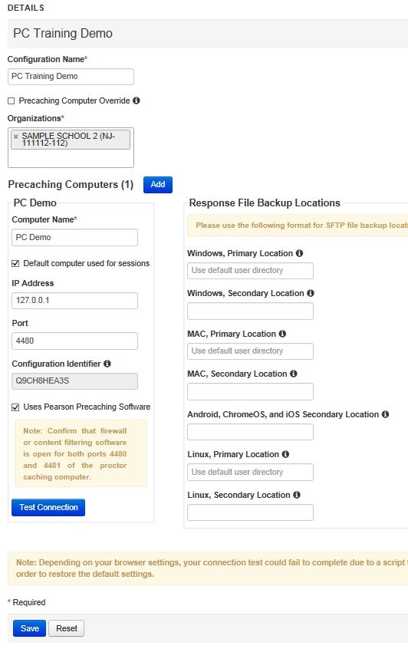
TestNav Configuration Details
With multiple TestNav settings, note that you can now:
  change the default configuration by checking or unchecking “Default computer used for sessions”
  delete configurations

Slide 32
PearsonAccess^{next} and Precaching Setups
TestNav configurations work from school to district. A school Precaching machine will take precedence over a district. If a school does not have a setup, then the district setup will apply.
The Precaching server option in Session Details will display only if there are two or more Precaching machines to choose from at the school or district (this can be used to override the default district/school TestNav configuration).

Slide 33
Precaching Test Content
  Choose Precache By Test under the Setup tab
  Select the grades and subjects needed, then select the Precache Server and click Precache

Slide 34
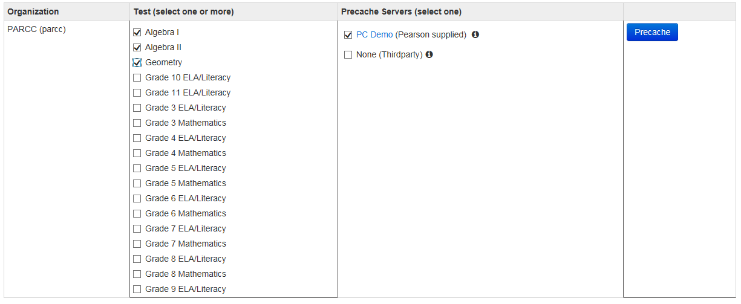
Precaching Test Content (By Test)
Click “Precache” on the Precache By Test screen.

Slide 35
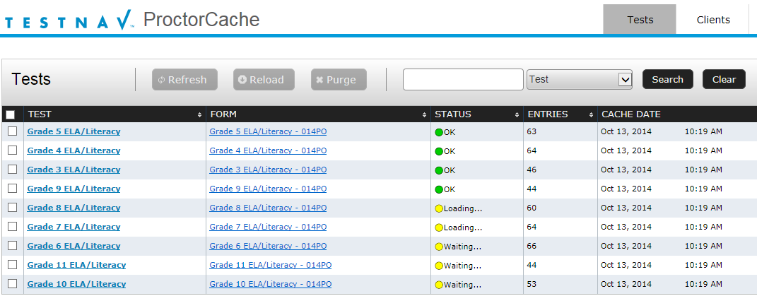
Precaching Test Content
Proctor Cache - Tests Screen will appear in a second window. If you do not see this window, re-attempt the Precaching Test Content process

Slide 36
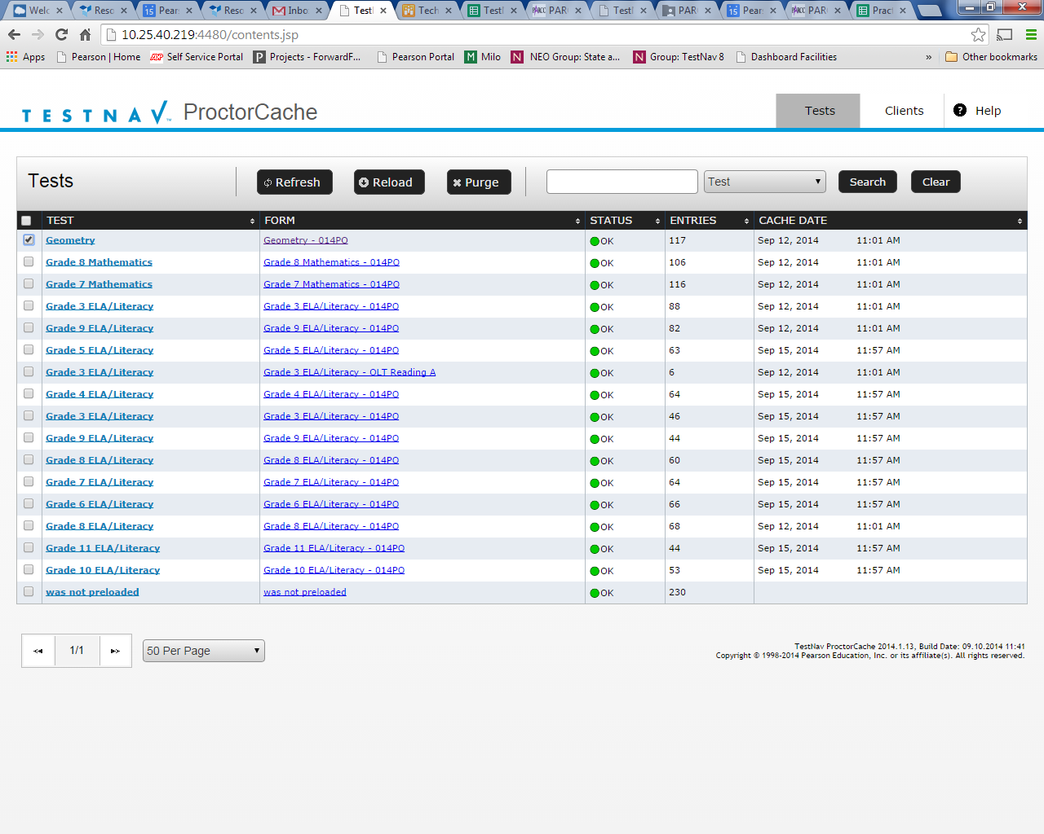
Proctor Caching Diagnostics
Select the Tests tab for information about test content and caching status
Select the Clients tab to monitor client connectivity

Slide 37
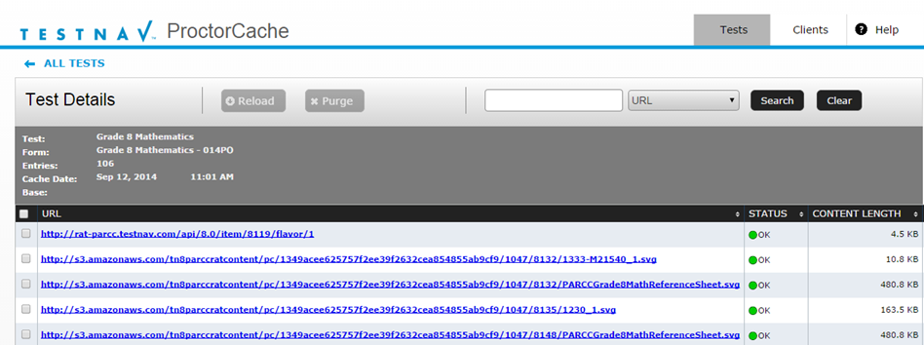
Tests Tab
Content is displayed at the Test and Form level
Functionality is available to purge selected test content. Purging is not required when re-caching test content
When clicking Purge a password will be required
Do not use Reload or Refresh, these actions do not function on New Jersey Content
Clicking on a test name will display individual items in a test, which are encrypted

Slide 38



Tests Tab – Status
OK – Content is cached
Not Loaded – Content is not cached
Waiting… – Preparing to download the content in queue
Loading… – Downloading the content
Failed to load content – There was a failure to download content
MD5 Check Invalid – MD5 comparison failed
MD5 Mismatch – MD5 comparison was successful but files did not match
In general, any status in red is a critical problem.

Slide 39
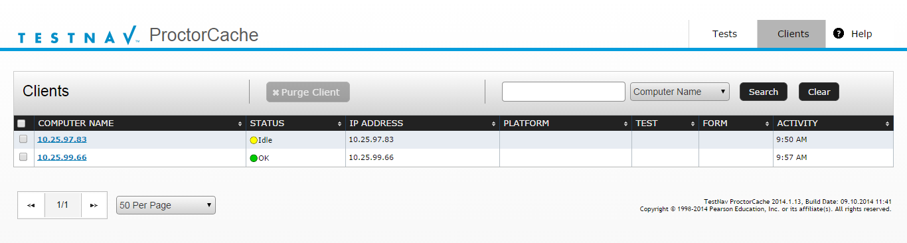
Clients Tab
Clients that have connected to TestNav are listed by IP address
Clicking on a computer name will display the Client Details screen, which displays information regarding a particular computer connecting to Proctor Caching

Slide 40
Clients List Tab – Status
Ok – Client is active
Idle – 5 to 30 minutes since client was active
Long Idle – 30 minutes to 12 hours since client was active
Clients are removed from the list after 12 hours of inactivity.

Slide 41
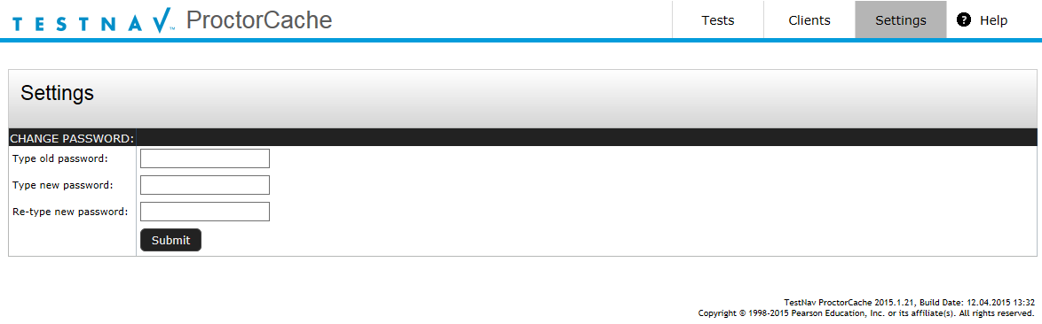
Settings Tab – Change Password
While logged into the Proctor Caching machine use the url: http://localhost:4480/
The Settings Tab will be available to change the password used to Purge the test content
For guidance on the ProctorCache password settings, please review the ProctorCache Password Settings section of the Set Up and Use ProctorCache page

Slide 42
Questions & Answers

Slide 43
Agenda
Part I: Before Testing - Technology Coordinator Preparation | Technology System Requirements Technology Setup
Part II: Before Testing - Test Coordinator Preparation | What’s new this year? PearsonAccess^{next} Student Readiness Infrastructure Trial
Part III: During Testing | Session Management Technical Troubleshooting
Part IV: After Testing | Session Clean-Up Resolve Critical Warnings Purge Test Content
Part V: Additional Information | Paper Materials Resources & Support

Slide 44
Part II: Before Testing – Test Coordinator Preparation
  Resources
  What’s new this year?
  PearsonAccess^{next}
  Navigating PearsonAccess^{next}
  Student Registration/Personal Needs Profile (SR/PNP)
  Create Sessions
  Print Student Testing Tickets
  Prepare Session
  Start Session
  Operational Reports
  Students Who Move Between Organizations
  Student Readiness
  Infrastructure Trial
  Where To Start? Who Should Be Involved?
  Create Sample Students
  Infrastructure Trial Checklist

Slide 45
Resources – Manuals for Test Coordinators
Resources located at https://nj.mypearsonsupport.com
Technology Information includes:
  Infrastructure Trial Guide
  PearsonAccess^{next} Online User Guide
  Hardware and Software Requirements
Manuals:
  Test Coordinator Manual (TCM) and Test Administrator Manuals (TAM) for computer-based and paper-based
  Accessibility Features and Accommodations (AFA) manual

Slide 46
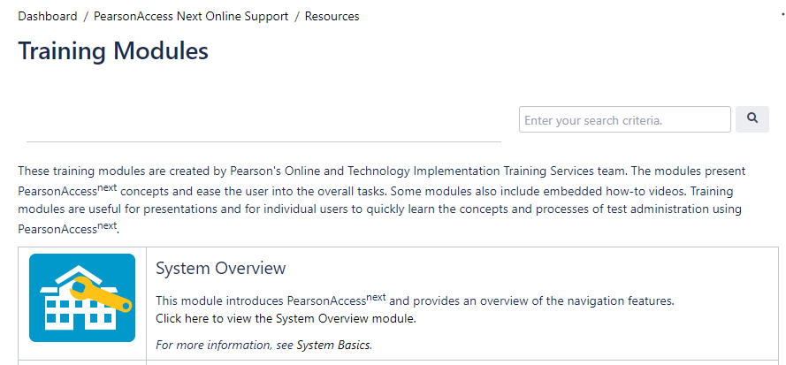
Resources – Training Modules for Test Coordinators
  PearsonAccess^{next} modules: https://support.assessment.pearson.com/x/H4BIAQ

Slide 47
What’s New This Year?
PearsonAccess^{next} Updates
  Simplified User Role Matrix
  For students receiving read aloud accommodations, an audio icon is displayed on the student test ticket.
  Added new filter for searching for students in Rejected Student Test screen to search by state Student ID (SID).
  Alert users before account timeout - 2 minutes before user automatic log out occurs due to inactivity, an alert popup will appear on the screen.
  New NJ Account Scope where current and future administration scopes will appear.

Slide 48
Student Registration and Personal Needs Profile
SR/PNP data is one file that is used to register students for the assessments and to customize the assessment to the student’s unique accessibility and accommodations requirements.
Note: The SR/PNP should be used before testing and during testing. The Student Test Update (STU) file should be used post testing.

Slide 49
Student Registration - Methods of Data Input
Data for all students must be loaded into PearsonAccess^{next} through either an SR/PNP file upload or the user interface.
File Upload
  Create/export and import a .csv file with all student registration and PNP information
  This process is more commonly used when creating or editing a large number of students
User Interface
  Complete the necessary tasks within PearsonAccess^{next} to register the students, assign them tests, and define their PNP requirements
Both methods use PearsonAccess^{next} to update the same student data fields; they require understanding of the Field Definitions and File Layout documents. More details on this information can be found by selecting Documentation under the Support heading in PearsonAccess^{next}.

Slide 50
Demonstration: PearsonAccess^{next}
Navigating PearsonAccess^{next}
Student Registration/Personal Needs Profile (SR/PNP)
  File Import
  User Interface

Slide 51
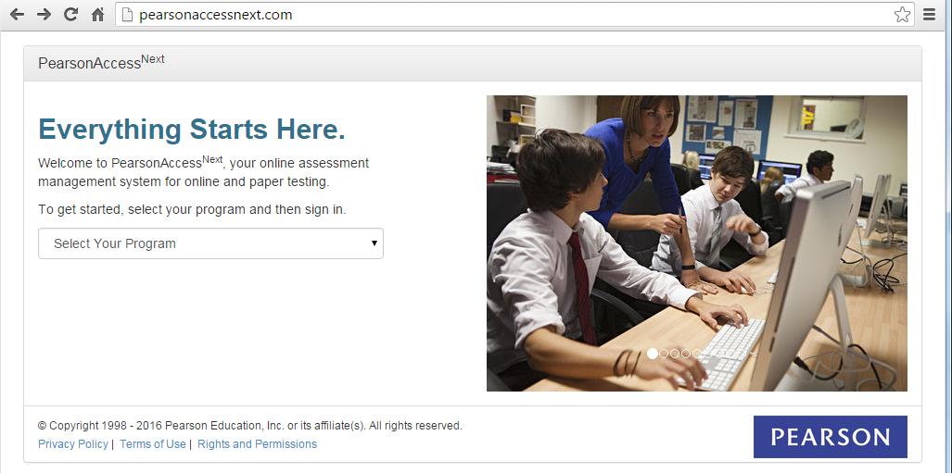
PearsonAccess^{next}
http://pearsonaccessnext.com/
Notes:
PearsonAccess^{next} is a management system. Access is based on your user account role type, meaning you will only see the data and perform only those tasks for which you have been authorized. Based on your role and add-on role in the system, you may do one or more of the following:
Create and manage organizations, participation, and staff accounts
Manage student registration/personal needs profiles for testing
Order additional materials
Track test material shipments to and from Pearson
The PearsonAccess^{next} website is located at http://pearsonaccessnext.com/
Initial state user accounts will be set up by Pearson based on information provided by each state. All other accounts are created by state, district, or school staff; please note school staff accounts cannot create accounts for district staff and district staff cannot set up accounts for state staff. Each new user will receive an email notification when his or her user account is created. To ensure users receive emails, have your IT department add @pearson.com and @support.pearson.com to your email system’s whitelist.
NOTE: The link in your initial user account setup email can only be used once. Therefore if you forget your password, you will need to request it again through the Forgot Password feature.

Slide 52
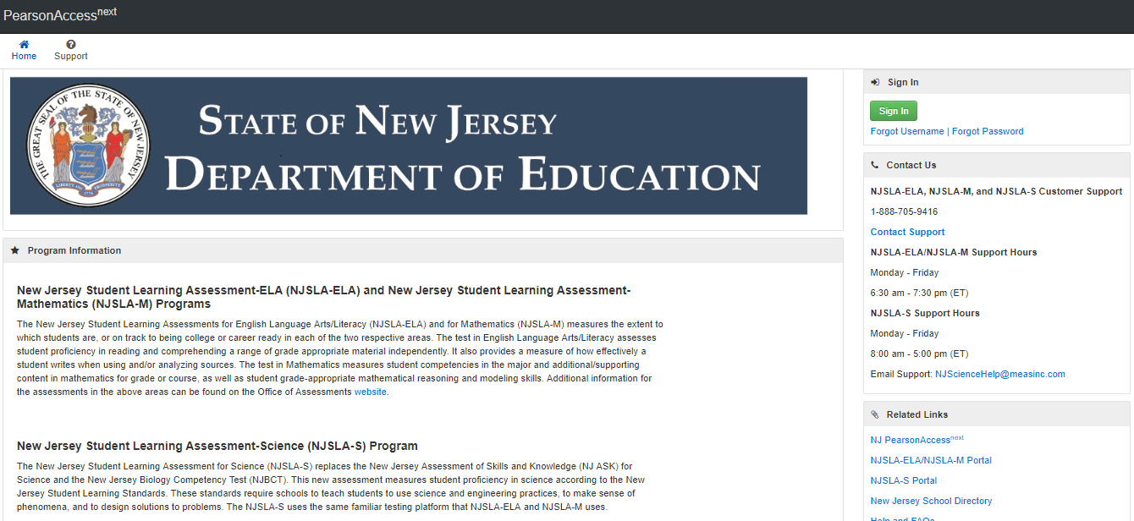
PearsonAccess^{next} — Login
https://nj.pearsonaccessnext.com/

Slide 53
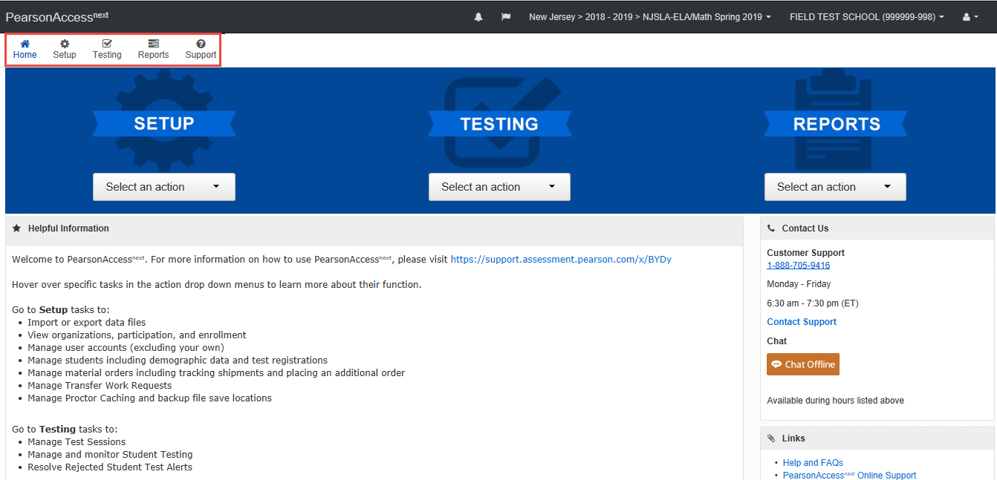
PearsonAccess^{next} — Home Page

Slide 54
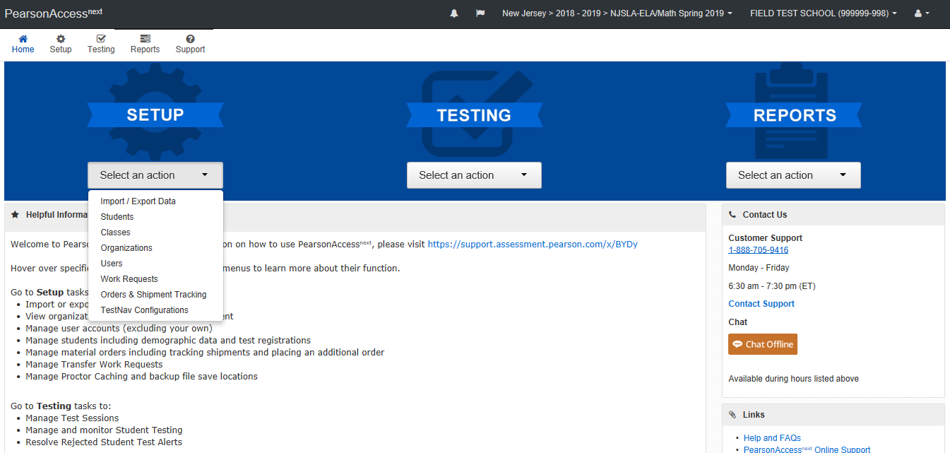
PearsonAccess^{next} — Home Page

Slide 55
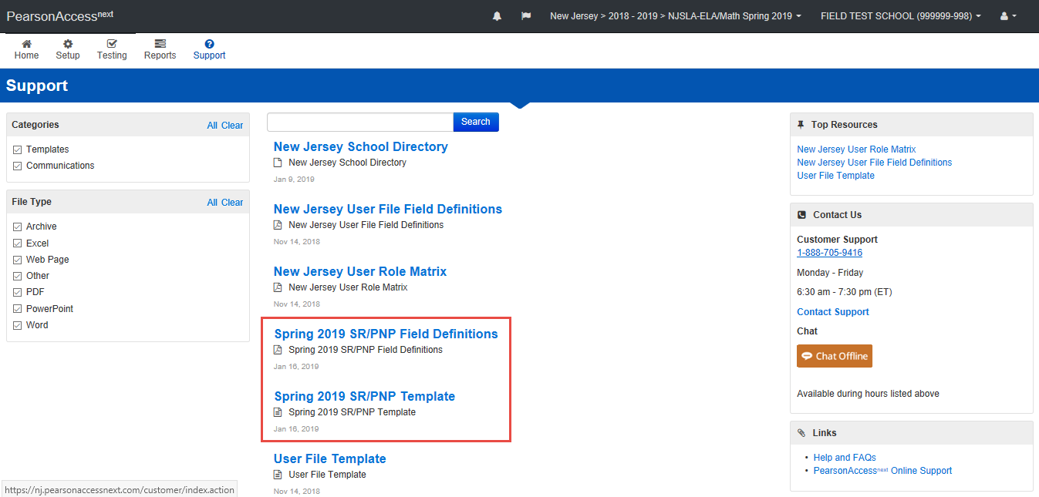
Import SR/PNP File

Slide 56
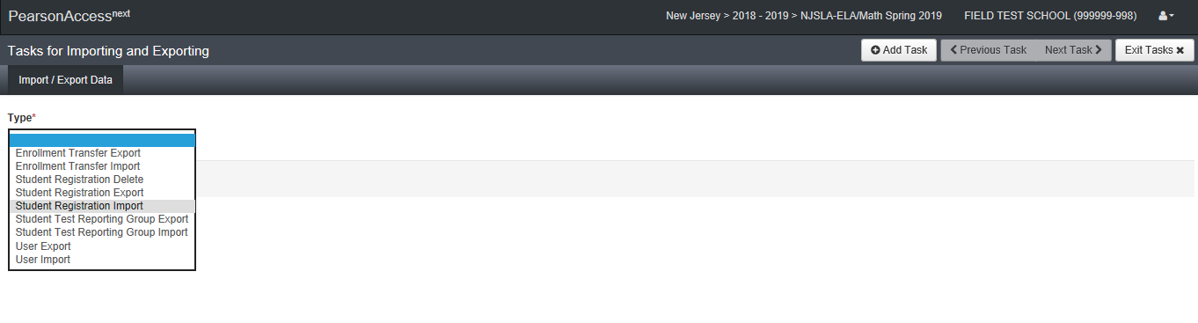
PearsonAccess^{next} — Importing and Exporting a System File

Slide 57
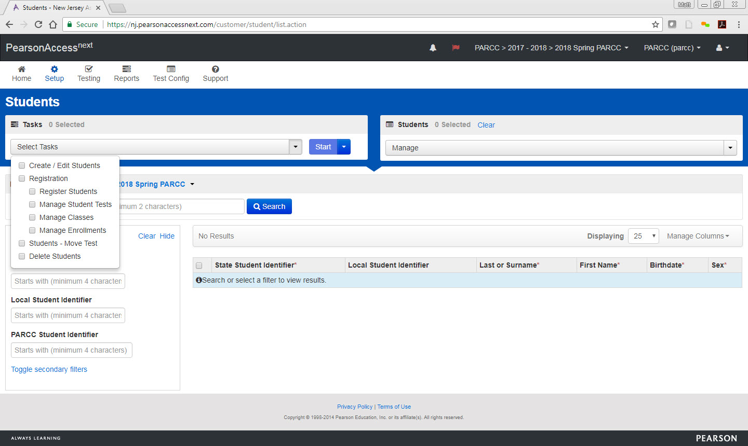
PearsonAccess^{next} — User Interface

Slide 58
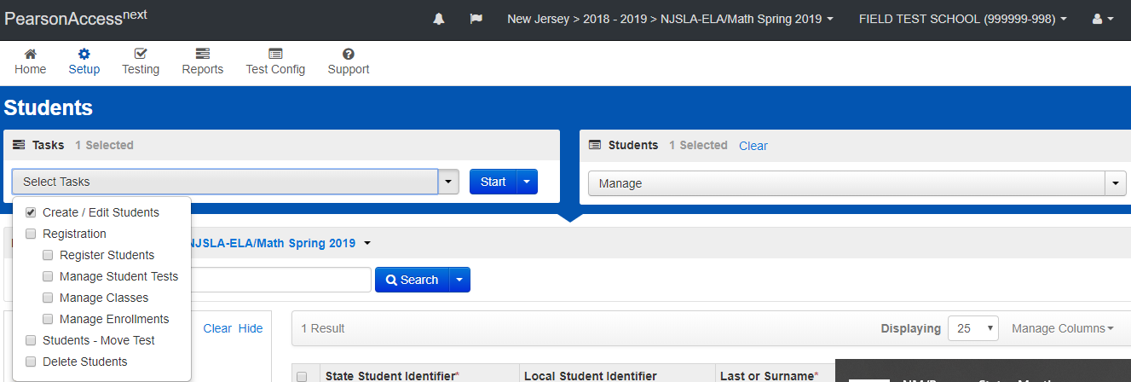
Create a New Student

Slide 59
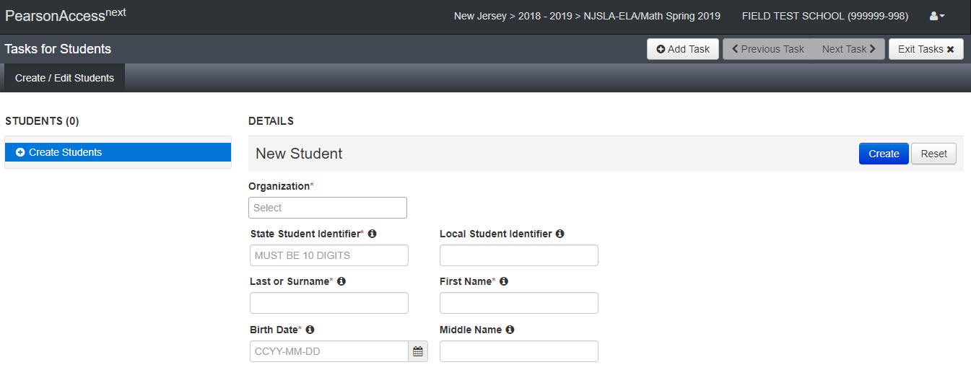
Create/Edit Students

Slide 60
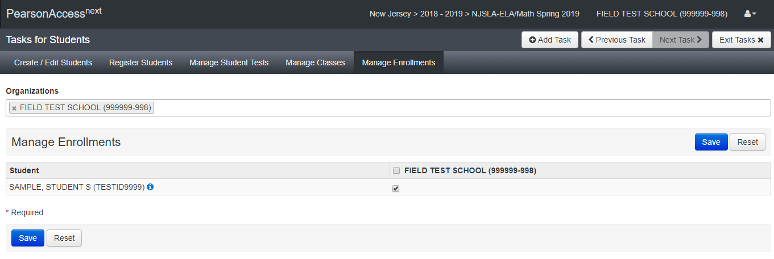
Enroll Students

Slide 61
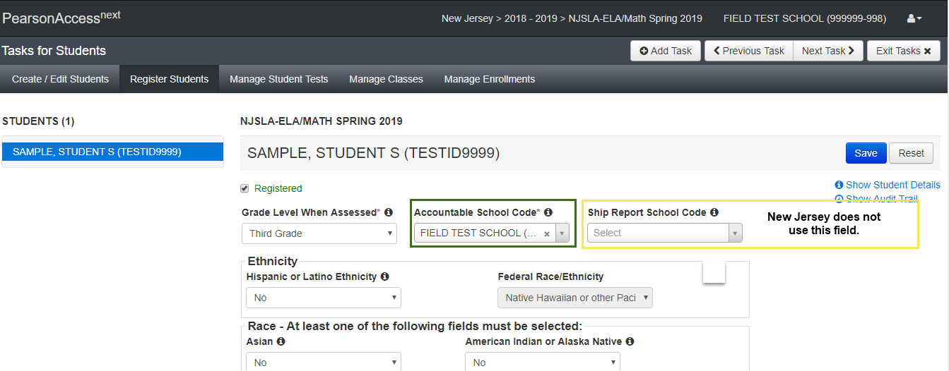
Register Students

Slide 62
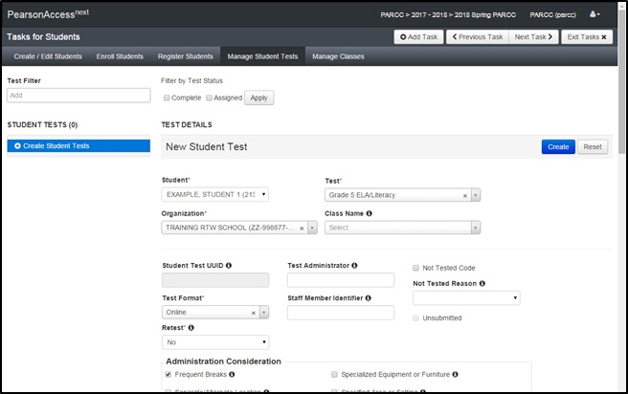
Manage Student Tests

Slide 63
Online Testing Management
Important Notes for Online Testing Management:
Human Reader or Human Signer: Students with this accommodation will need to be grouped in a separate session and the session will have the “Proctor Reads Aloud” option checked
Text-to-Speech: Students with this accessibility feature can be in sessions with other students. You can test these students in the same room if headphones are used

Slide 64
Demonstration: PearsonAccess^{next}
Create Sessions
  Adding Students
Print Student Testing Tickets
Prepare Sessions
Start Sessions

Slide 65
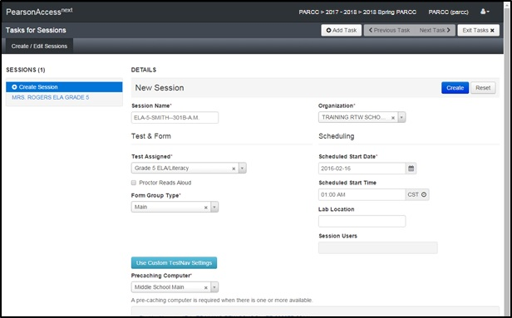
Create a Session

Slide 66
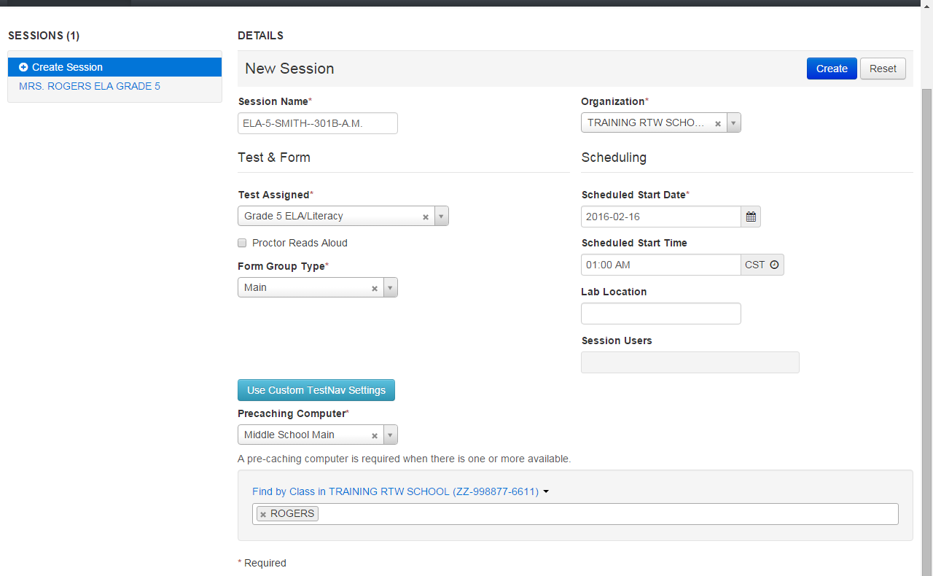
Create a Session
NJ Naming Convention:
ContentArea-Grade-TestAdminLastName-RoomNumber-AMorPM-ExtendedTime-IEP-504-ELAccommodation

Slide 67
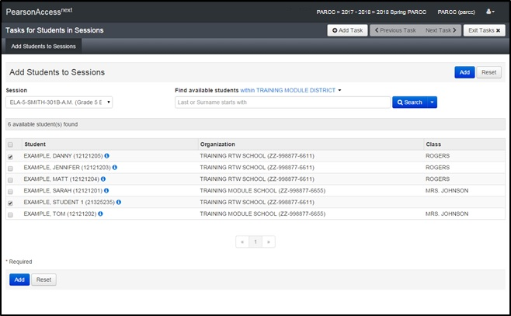
Add Students to Sessions

Slide 68
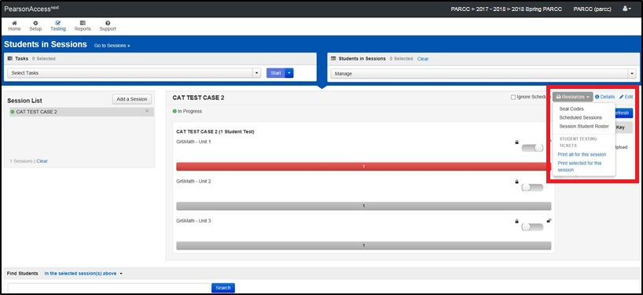
Print Student Authorization Tickets
Student test tickets contain the log in and TestNav URL that students need in order to access their assigned tests. Test tickets are secure materials and can only be printed by the District/School Test Coordinator.

Slide 69
Prepare Sessions
This step can be completed 1 school day prior to starting a test session
  Allows for the starting of multiple test sessions at one time
  Removes the 250 student limit for test sessions
  Can only be done by users with the District Test Coordinator (DTC) or School Test Coordinator (STC) roles
This step will assign forms to each student in the test session
  Prior to completing this step, ensure that the appropriate accommodations are assigned to students
  If accommodations are not accurately indicated prior to this step, the student will need to be removed from the test session, have their PNP updated, and then be added back to the test session
Once this step is completed, and the testing window is open, the test session can be started.

Slide 70
After Hours Testing
A testing schedule override must be requested for specific sessions that require after hours testing
Sessions must be prepared and the session names must be provided to the appropriate grade-level Statewide Assessment Coordinator when requesting an after-hours testing override

Slide 71
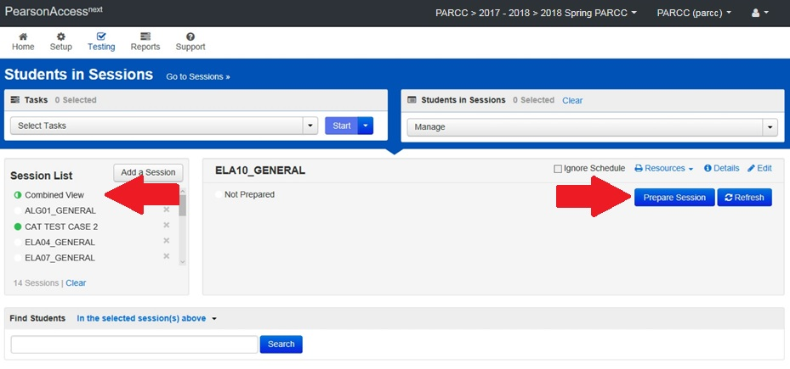
Prepare Sessions

Slide 72
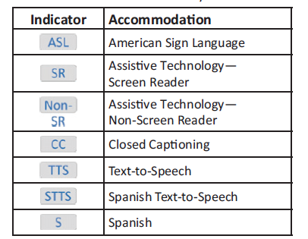
Accommodation Indicators
A marker appears next to the Student ID on the Students in Session screen if an accommodation was identified for a student record on the Manage Student Test Screen or through an SR/PNP import
These forms are independent forms and cannot be combined.
Use these indicators to identify errors in accommodation settings

Slide 73
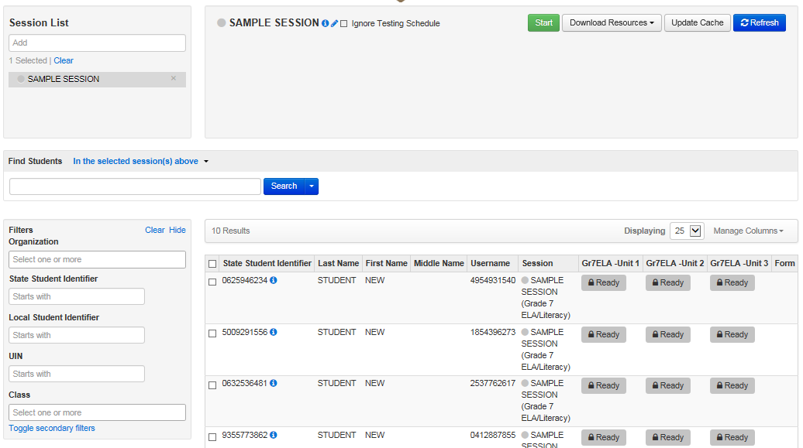
Start Sessions
A session must be started and a unit must be unlocked before students can log in and take their tests.
This can be done at any time before testing once the New Jersey testing window is open and the session has been prepared.

Slide 74
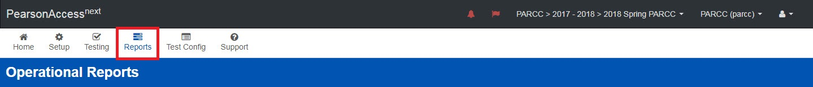
Operational Reports
Operational Reports can be found by going to Reports and then selecting Operational Reports. Reports that are useful for pre-administration activities:
Student Counts: Display the number of enrolled and registered students
Students Registered but not Assigned to a Test
PNP/Accommodations for Student tests: List of students and tests for specific accommodations
Sessions Roster: List of all students for all sessions
Students with Online Test but not Assigned to a Session
Students where Accountable District/School is different from Testing District/School (also for accountable organization)

Slide 75

Students Who Transfer Between Organizations
Old School
New School
Old School
New School
Scenario 1:
Same District
DTC
moves student
Scenario 2:
Different Districts
DTC uses Work Request

Slide 76

Students Who Move Between Schools Within a District
Use the User Interface to move the student between schools.
  *Remove the student from his/her assigned
  Test Session (for online testing, if applicable).
  Change Student Organization in
  Create/Edit Students task screen
  Update Accountable Organization on the Register Students task screen (if applicable)
  Add the moved student to a test session.
  *Note: Online tests currently assigned to a session will automatically be placed in a transfer session under the transfer to organization when the organization enrollment is updated.
Old School
New School
Same District
DTC

Slide 77
Work Request – Student Transfer Process
District B completes a work request within PearsonAccess^{next}
District A approves the work request
  The online tests assigned to the student are automatically transferred to District B
    If a student was in a session, the tests are placed in a “Transferred [Subject - Grade]” test session
    The tests must be moved into another test session, transferred sessions cannot be prepared
  The Responsible School Code on the Register Students tab will need to be updated
  For paper-based testing students, complete the work request process to transfer the student record and follow the New Jersey District-to-District Chain of Custody form for Transferred Paper-based Testing Materials
Old School
New School
Scenario 2:
Different Districts
DTC

Slide 78
Work Requests – Releasing District
Check email and PearsonAccess^{next} periodically
Look for the red bell at the top of the PearsonAccess^{next} home screen
  Click on the bell to go to the pending requests for transfer
  Verify that the student listed in the Work Request has moved from your district and
    Approve the transfer
  If the student has not moved from your district
    Reject the transfer
      You will have to provide reason (e.g., student has not moved)
    The other district may have requested the wrong student
  If there is an error in the school field upon opening the work request, decline the request (the student has already been removed from your district)

Slide 79
Work Requests – Receiving District
Review the student registration in all applicable administrations and update the responsible school and district
Updates to a accountable school that is not within your district must be done via a file upload.
Updates to schools within your district can be done in the UI or via a file upload.
If the responsible school and district field appears blank in the UI, then the student has a accountable school outside of your district
Use the Operational Report “Students Where Accountable District/School is different from Testing District/School”
  If your district should be the accountable district, change this in the student’s registration either via the UI or through a SR/PNP file upload

Slide 80
Demonstration: PearsonAccess^{next}
Students Who Transfer Between Organizations
Operational Reports: (For Accountable Organization) Students where Accountable District/School from Testing District/School

Slide 81
Student Readiness
Practice Tests:
Practice tests are available for all accessibility features and accommodations including TTS, ASL, Screen Reader, Closed Captioning, Large Print, and Braille at:
https://nj.mypearsonsupport.com/
Tutorials:
Tutorials for TestNav 8, paper, online, and TTS, ASL and Closed Captioning with functionality guides are located at:
https://nj.mypearsonsupport.com/
Notes:
Example: Grade 5

Slide 82
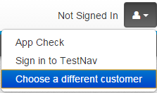
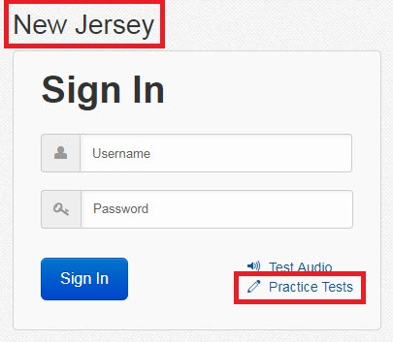
Student Readiness
Non-secure Practice Tests and Tutorials are also available in the TestNav Apps. This applies to Chromebooks, iPads, Androids, and the TestNav Desktop App.
Navigate to the App Home Screen and Choose “New Jersey”
  If you’re already on a login screen click the User icon in the top right and select “Choose a different customer” to return to the App Home Screen
Click the Practice Tests link to access Practice Tests and Tutorials

Slide 83
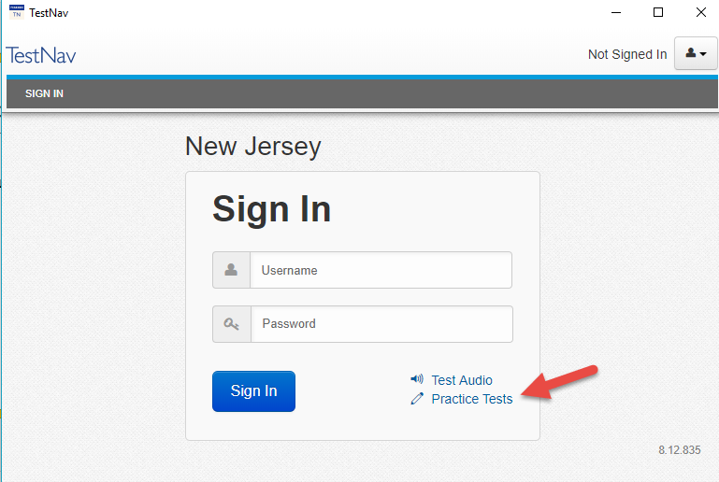
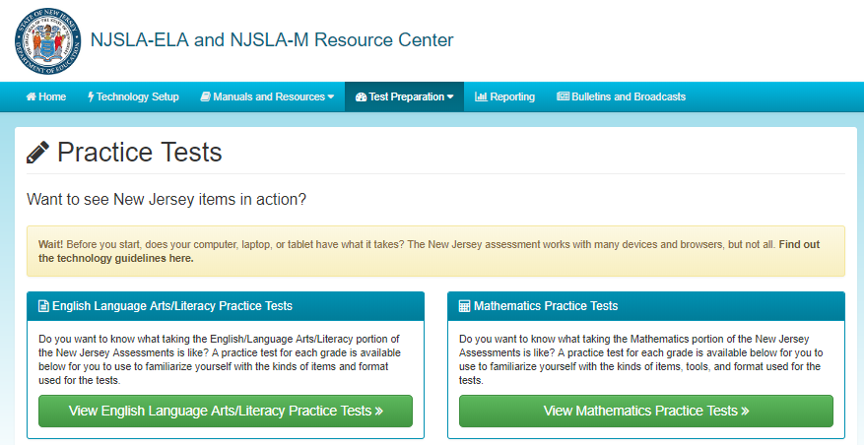
Accessing Non-Secure Practice Test
Access non-secure practice tests from the TestNav App or from https://test-nj.mypearsonsupport.com/.

Slide 84
Infrastructure Trial Introduction/Purpose
Dress Rehearsal
The purpose of an infrastructure trial is to confirm that:
  Testing devices are setup correctly
  Network will bear the full load
  Proctor Caching is working
  Participating staff know what to do for New Jersey computer-based assessments
  Students are familiar with the computer-based tools and format and logging into TestNav.

Slide 85
Infrastructure Trial Preparation
Prior to the Infrastructure Trial, there is technology setup that needs to be completed by Technology Coordinators, and a set of tasks in PearsonAccess^{next} that need to be completed by Test Coordinators. The duration of these setup tasks can vary from school to school.
The Infrastructure Trial should take approximately 60 minutes to administer. Schools are encouraged to provide any feedback on the Infrastructure Trial to their DTC. DTCs should contact the appropriate New Jersey State Test Lead with feedback and/or concerns regarding software or hardware issues.

Slide 86
Infrastructure Trial – Who Should Be Involved?
You should involve all district and school personnel responsible for participating in computer-based assessment. It provides the opportunity to collectively evaluate the test environment and identify/resolve potential issues prior to testing. For example, you would want to include:
  Test Coordinators
  Test Administrators
  School technology staff
  Student participation is recommended
District and/or School
It is up to districts and schools to decide if the Infrastructure Trial needs to be completed at the district level or at the school level.

Slide 87
Infrastructure Trial - Where To Start
The Infrastructure Trial is conducted using the PearsonAccess^{next} Training site at https://nj.mypearsonsupport.com/.
Verify that all staff members participating in the trial have received user IDs and passwords for the PearsonAccess^{next} Training site. Also have staff members review the Manuals and Training Modules.
Refer to the Spring 2019 New Jersey Infrastructure Trial Readiness Guide via https://nj.mypearsonsupport.com for complete instructions.

Slide 88
Technology Setup
Complete Technology Setup prior to Infrastructure Trial:
Configure the Network
Proctor Caching
Device Readiness
TestNav and Proctor Caching Configurations

Slide 89
PearsonAccess^{next} Setup
Districts/schools will need to complete the following in PearsonAccess^{next} prior to the Infrastructure Trial:
Create Sample Students
Create Sessions
Prepare Sessions
Print Student Testing Tickets
Student Readiness
  Practice Tests
  Student Tutorials

Slide 90
Demonstration – Infrastructure Trial
Create Sample Students
Create Sessions
PreCache Test Content
Prepare Sessions
Print Student Testing Tickets

Slide 91
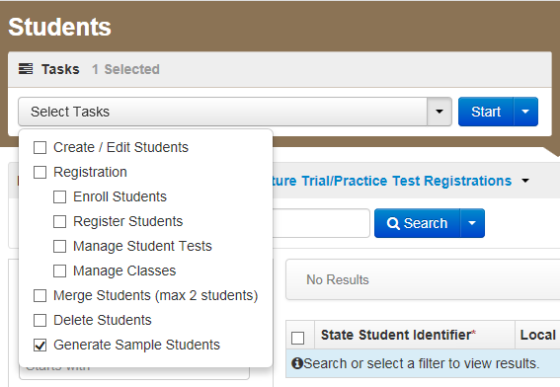
Create Sample Students
Log into the PearsonAccess^{next} Training Site
Choose the Administration
Click Setup and select Students
Select Generate Sample Students from the Tasks menu
Click Start to continue

Slide 92
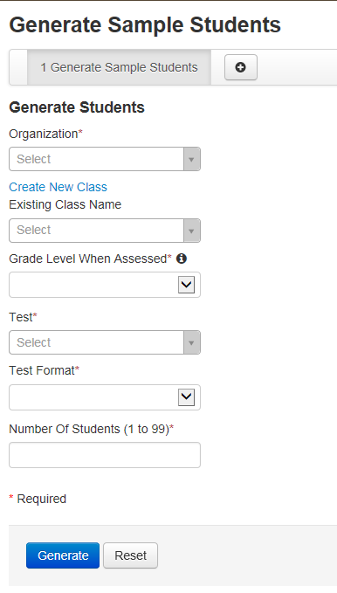
Create Sample Students
Complete the Generate Sample Students screen
Recommended: Add the Sample Students to a Class
Click Generate to complete the process

Slide 93
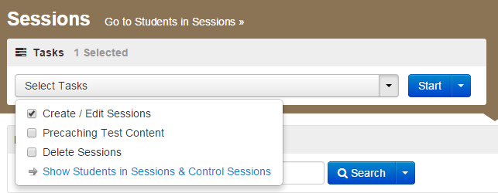
Create Sessions
Go to the Testing tab and click Sessions
From the Select Tasks dropdown menu, select Create/Edit Sessions, and click Start
A session includes all of the units for a subject and may be scheduled across one or more days. Sessions are scheduled by subject and the group of students testing that subject together (as set up in PearsonAccess^{next} for computer-based testing).

Slide 94

Create Sessions
Complete Session Details

Slide 95

Create Sessions
Add Sample Students to a Session by Class

Slide 96

Session Management – Prepare a Session
A session must be prepared before students can log in and take their tests. This can be done at any time the training site is available for Spring Infrastructure Trials.

Slide 97
Session Management – Start a Session

Slide 98

Session Management – Download Resources
Print Testing Tickets
Print Testing Tickets

Slide 99

Infrastructure Trial
Ready to Begin Your Infrastructure Trial?
Technology Setup Complete
Practice with Student Tutorials and the non-secure Practice Tests available at https://nj.mypearsonsupport.com/.
PearsonAccess^{next} Training Site setup has been completed and student testing tickets have been printed available at https://trng-nj.pearsonaccessnext.com/.
Review Infrastructure Trial Guide available at https://nj.mypearsonsupport.com/.

Slide 100
Infrastructure Trial
What to do during the Infrastructure Trial
  Prepare
  Conduct
  Closing & Lessons learned

Slide 101
Questions & Answers

Slide 102
Agenda
Part I: Before Testing - Technology Coordinator Preparation | Technology System Requirements Technology Setup
Part II: Before Testing - Test Coordinator Preparation | What’s new this year? PearsonAccess^{next} Student Readiness Infrastructure Trial
Part III: During Testing | Session Management Technical Troubleshooting
Part IV: After Testing | Session Clean-Up Resolve Critical Warnings Purge Test Content
Part V: Additional Information | Paper Materials Resources & Support

Slide 103
Part III: During Testing
Session Management
  Lock/Unlock Units
  Monitor Testing
  Change a Student’s PNP
  Make-Up Testing
  Mark Tests Complete
  Void and Not Tested
Technical Troubleshooting
  Common Error Codes

Slide 104
Session Management
Administrators will need to lock and unlock Units of the test for students to access units
Only 1 Unit of a student’s test can be unlocked at a time in a session. That unit will need to be locked before unlocking the next unit:
  Scenario 1: On day one of testing, the Test Administrator unlocks Unit 1 at the session level for all students. The students login to Unit 1 and complete their tests. Unit 1 must be locked before Unit 2 can be unlocked.
  Scenario 2: When completing make-up testing the Test Administrator can unlock tests at the Student level rather than the Session level. This means each student in the room can be in different Units at the same time, but each student still only has access to a single unit of the test. The compatibility of scripts, unit times, and accommodations must be considered when scheduling make-up sessions.
Students can only login to tests if they are in a Ready or Resumed status in PearsonAccessnext

Slide 105
Demonstration – Session Management
Lock/Unlock Units
Monitor Testing
Resume Students

Slide 106

Session Management – Lock/Unlock

Slide 107

Session Management – Monitor Testing (1 of 3)

Slide 108

Session Management – Monitor Testing (2 of 3)

Slide 109

Session Management – Monitor Testing (3 of 3)

Slide 110

Session Management – Student Status
Student Test Status Key

Slide 111


Session Management – Resume Students
Option 1 to Resume Students:
Option 2 to Resume Students:

Slide 112
Session Management – Change a Student’s PNP
In the event that an incorrect PNP has been assigned to a student and the test session has been prepared:
Only certain PNP options can be changed without removing a student from the session (Examples: Answer Masking or Color Contrast). Other PNP options will require that the student be removed from the session before the PNP can be updated (Examples: Text-to-Speech or Spanish). The student can be re-added to the session after changing a student’s PNP.
  The Accommodation Indicators on the Students in Sessions screen can be used to verify that an accommodated form has been assigned to a student
  Re-caching is not necessary when changing form assignments or adding new students to a session

Slide 113
Session Management - Make-Up Testing
Important Notes for Make-Up Testing:
Schools can choose to move students who miss a day of testing into separate make-up sessions, or they can leave students in their original sessions and manage their make-up testing using the Combined View
Units can be taken out of order for make-up testing only
Documentation: The Make-Up Testing Directions for Computer-Based Testing guide can be found on https://nj.mypearsonsupport.com/.

Slide 114
Make-Up Testing - Session Checklist
Create a new make-up testing session:
  Create a make-up test session and add the students.
  Unlock the unit that the student will be testing.
  Print and use new Student Testing Ticket.
  Administer the test.
  Have the student submit the unit when finished.
Keep the original testing session:
  Unlock the unit that the student will be testing.
  Use the original Student Testing Ticket to log in.
  Administer the test.
  Have the student submit the unit when finished.

Slide 115

Session Management – Mark Test Complete
Note: In order to mark a test complete, a user must have the District Test Coordinator or School Test Coordinator Role

Slide 116

Session Management - Void and Not Tested
NJSLA Score Invalidation: During any testing, there may be a necessity to invalidate (Void) a student’s test. Under Students, use the task Manage Student Tests.
Documentation regarding the use of Not Tested and Void Codes be found in the NJ State Appendix within the Test Coordinator Manual.
Note: In order to void a test, a user must have the District Test Coordinator or School Test Coordinator Role.

Slide 117

Operational Reports
Operational Reports can be found by navigating to Reports > Operational Reports in PearsonAccess^{next}.
Reports that are useful during assessment administration activities:
  Students Currently Testing Online (Will be available before testing begins)
  Students With Multiple Tests
  Void Score Test (Do not Report)
  Not Tested Student Tests

Slide 118
Technical Troubleshooting During Testing
Common Error Codes
1001: “Your test has been saved. Please notify your test administrator.”
  Early Warning System initial message, does not indicate the issue, another error code will follow.
1009: “Unable to download test content.”
  Network connection issue between the testing device and Pearson servers.
3005: “TestNav has detected that another application attempted to become the active window.”
  This could be caused by pop-ups in the background.
5032: “TestNav has detected a blacklist application running…”
  Close the specified application in the error message and have the student sign in again.
8026: “Unable to connect to the proctor caching computer. Please contact your administrator.”
  Network connection issue between the testing device and the local Proctor Caching device.
3020 (new): “TestNav has detected that Command+Option+Esc has been typed. TestNav has been shut down. You may need assistance from your test monitor to restart the test.”
  TestNav exits the test and displays this error when a user types Command+Option+Esc while testing. The proctor must resume the test before the student can sign in to TestNav again.
3022 (new): “TestNav has detected that Ctrl+Alt+Del has been typed. TestNav has been shut down. You may need assistance from your test monitor to restart the test.”
  TestNav exits the test and displays this error when a user types Ctrl+Alt+Del while testing. The proctor must resume the test before the student can sign in to TestNav again.
  Additional information can be located on the TestNav Trouble Shooting Page: https://support.assessment.pearson.com/x/CgACAQ.

Slide 119

Technical Troubleshooting During Testing
9059: “The username or password you entered is incorrect.”
  This is common when students are using the TestNav Apps
To get on the correct login page click the User icon in the top right and select “Choose a different customer”. Then pick the correct page from the Apps Home Screen.
Note: The student testing ticket will list the correct site to use the sign-in credentials (for browser-based testing).

Slide 120
Technical Troubleshooting – What To Do?
Resume the student in PearsonAccess^{next}
Have the student log in again on the same testing device
If the same error occurs repeatedly, or if the same error is affecting multiple students, contact your Technology Coordinator
Do not move the student to another testing device unless the student safely exits the test using the log out feature. This is to help prevent student responses from becoming more difficult to retrieve
  If the school has set up secondary save locations in the TestNav Configuration for all of the device-types, TestNav will always look in the primary and secondary save locations for a Student Response File when the student logs into the test.
See resources available here: https://support.assessment.pearson.com/x/CgACAQ.

Slide 121

TestNav Early Warning System and Error Codes
TestNav Error Documentation:
TestNav 8 Online Support:
  https://support.assessment.pearson.com/x/BAACAQ
  EWS Triggers:
  https://support.assessment.pearson.com/x/DgACAQ
  TestNav Error Codes:
  https://support.assessment.pearson.com/x/DwACAQ
  SRF and Log Files:
  https://support.assessment.pearson.com/x/DAACAQ

Slide 122
Questions & Answers

Slide 123
Agenda
Part I: Before Testing - Technology Coordinator Preparation | Technology System Requirements Technology Setup
Part II: Before Testing - Test Coordinator Preparation | What’s new this year? PearsonAccess^{next} Student Readiness Infrastructure Trial
Part III: During Testing | Session Management Technical Troubleshooting
Part IV: After Testing | Session Clean-Up Resolve Critical Warnings Purge Test Content
Part V: Additional Information | Paper Materials Resources & Support

Slide 124
Part IV: After Testing
Session Clean-Up
  Mark partially consumed tests complete
  Remove unconsumed tests from prepare and started sessions
  Stop Sessions
  Operational Reports
Resolve Critical Warnings
Purge Test Content

Slide 125


Session Clean-Up - Stop Sessions
All prepared and started sessions should be stopped at the conclusion of the test administration window.
Remove unconsumed tests from prepare and started sessions. Prepared sessions will need to be started.
All partially consumed tests must have all units in a Marked Complete or Completed status, in order to stop a session. Tests are only scored once all units are in a complete or marked complete status
Students in Exited or Resumed status can be moved to other sessions.

Slide 126

Mark Student Tests Complete
Student tests must be assigned to a started test session in order to mark tests complete.
Only student tests that have been started should have units marked complete. Started test is defined as a test the student has logged into one or more units of the test.
Student tests that have all units appearing in a Ready status should have the Not Tested Flag and Reason Code populated, and should not have units marked complete.

Slide 127

Remove Unconsumed Tests from Sessions

Slide 128


Resolve Critical Warnings
If the flag at the top of the page is red, there may be students with warnings and errors that should be resolved before the test administration closes.
Click on the warning or errors to go to the Students page.
Select the students who have warnings and use the “Register Students” task to view/resolve.

Slide 129


Resolve Critical Warnings
The Register Students task will display the student’s warnings and errors. In this example, the student’s warnings are within their Ethnicity and Student Status fields.
You will need to fill-in these fields and click Save to remove the Critical Warnings.

Slide 130

Paper-Based Testing – Rejected Student Tests
A student’s paper-based test is sometimes rejected due to a mismatch of information on a student’s paper test booklet and what has been loaded into PearsonAccess^{next}.
Demographic information, such as an incorrect birthdate or gender can cause a rejected test.
These must be corrected before a test can continue on to scoring.

Slide 131

Purge Proctor Caching Content
After the test administration is over, it is a best practice to purge (delete) the test content from the proctor caching computer(s).

Slide 132
Operational Reports
Operational Reports can be found by going to Reports > Operational Reports
Reports that are useful for post-administration activities:
Online Student Tests Marked Test Complete
Students with Warnings
Students Tests That Have Been Assigned But Have Not Yet Completed
Students Where Accountable District/School is Different From Testing District/School
(For Responsible Organization) Students where Responsible District/School is different from Testing District/School

Slide 133
Questions & Answers

Slide 134
Agenda
Part I: Before Testing - Technology Coordinator Preparation | Technology System Requirements Technology Setup
Part II: Before Testing - Test Coordinator Preparation | What’s new this year? PearsonAccess^{next} Student Readiness Infrastructure Trial
Part III: During Testing | Session Management Technical Troubleshooting
Part IV: After Testing | Session Clean-Up Resolve Critical Warnings Purge Test Content
Part V: Additional Information | Paper Materials Resources & Support

Slide 135
Part V: Additional Information
OnDemand Reporting
Paper Materials
  Key Dates for New Jersey
  Initial Orders
  Additional Orders
Personally Identifiable Information (PII)
Resources & Support

Slide 136
OnDemand Reports
OnDemand reports will be available in PearsonAccess^{next}
  OnDemand reports can be used for planning related to graduation and Summer New Jersey testing
  Specific dates for the availability of OnDemand reports will be announced at a later date via a NJSLA bulletin

Slide 137
Paper-Based ELA and Math
Testing Key Dates
Event | Date
Paper-based test materials arrive in New Jersey districts | No later than March 22, 2019
Processing for paper-based test materials may begin as early as | April 29, 2019
Deadline to return scorable materials to Pearson (1 week after testing) | Regular Admin: May 6, 2019 Spring Block HS: May 13 ,2019
Additional Order Window Closes (Ancillaries) | May 10, 2019

Slide 138
Paper-Based Science
Testing Key Dates
Event | Date
Paper-based test materials arrive in New Jersey districts | No later than April 29, 2019
Deadline to return scorable materials to Measure Incorporated (MI) | No later than May 24, 2019
Additional Order Window Closes (Ancillaries) | April 25-May 8, 2019 (Test Materials) May 9-June 13, 2019 (Coordinator Kit Materials)

Slide 139
Initial Materials Order
How is it Generated and What is Included in an Initial Order:
Based on your Student Registration PNP file
You will receive test materials including paper-based accommodations for paper-based accommodated student, if indicated in SR/PNP
Tactile graphics for computer-based testing will be included in your initial order

Slide 140
Additional Order Submission
Late Student Registration Submissions:
If you missed the deadline for the initial materials order, follow these steps:
Import a Student Registration PNP Import File for students not yet registered or who have a change in their PNP
Submit an order for additional materials via PearsonAccess^{next}
Notes:
If your Student Registration PNP File is not imported by the initial administration deadlines for the test administration, an initial order for test manuals and paper-based accommodated test materials will not be generated and you will need to submit an additional order.
Student Registration must be imported into PearsonAccess^{next} for students not yet registered for a test administration. This information will to allow students test results to be processed and reported to the correction organization.
Test Coordinators must order additional paper-based accommodated test materials for each participating school via the Orders & Shipment Tracking page in PearsonAccess^{next}. Details regarding the process for completing an additional order will be provided later in this presentation.
As a reminder to decrease an unexpected surplus of materials, do not submit an additional order if you are expecting an initial order of materials. You will want to first receive the initial order and identify if additional materials are needed. You will then place an order for additional materials at that time.

Slide 141
Receiving Test Materials
  Initial materials will be received 2 weeks prior to your district start date
  Materials are packaged by school and shipped to the address for your organization indicated in PearsonAccess^{next}
  Quantities, which include 5% overage per school, are derived from the information provided in the Student Registration File
Notes:
Initial shipments of secure test materials, including accommodated materials, will be delivered 2 weeks prior to your district assessment window start date.
Test materials will be packaged by school and shipped to the address listed in PearsonAccess^{next}. Please refer to your State policy to determine if materials are shipped to disticts or schools.
Quantities for test materials are based on the information provided in the Student Registration File. This includes student enrollment numbers, and applicable accommodated test materials. Quantities will include a 5% overage of test materials per school.

Slide 142
Contents of Initial Shipment
Test Coordinator Kit
  Resealable plastic bag (holds all materials)
  Paper Bands
  Pearson Scorable and Nonscorable Labels (in different colors)
  UPS Ground return labels for Scorable and Nonscorable materials
  Pre-printed/pre-gridded Used Test Booklet/Return School Header
  Student ID Labels and Roster
  Return Instructions Sheet
  Shipping Carrier Return Instructions
Packing List and Chain-of-Custody Form
Test Coordinator Manuals
Test Administrator Manuals
Test Booklets
Math Reference Sheets, Rulers, and Protractors, if applicable
Large Print kits
Braille kits
Read Aloud kits
Notes:
This list of materials shows you what you should receive in your initial shipment of paper-based test materials. For example, the Test Coordinator Kit will contain the Student ID Labels and Roster.
Note that Test Booklets will be shrink-wrapped in packages of 5. The Large Print kit will include two Test Booklets, one in large print for the student and one in standard print for transcription purposes. The Read Aloud kit will include two Test Booklets, one for use by the student and one for use by the Test Administrator administering the read-aloud accommodation.
Shrink-wrapped packages can be opened at the school level no earlier than two school days prior to the day of testing. Test Administrators giving the human read aloud or translation for the mathematics accessibility feature or the ELA/literacy accommodation for students with disabilities must be given two full school days to review the items in conjunction with the read aloud protocol and the audio guidelines, to ensure consistency of oral and/or signed presentation. Contact your state assessment office if you have any questions. These test materials are not to be distributed to the Test Administrator until the day of testing.

Slide 143
Chain-of-Custody Forms
  District Chain-of-Custody Form for Initial Shipment of Materials Form indicates:
    A full list of materials within the district
    Form and security numbers
    Quantity sent
    Delivery information for each secure test material
    LTC and STC Sign-off for quantity received
  School Chain-of-Custody Form indicates:
    Security numbers for each secure test material
    Student and Test Administrator assignment
    Date and time for checked-out and checked-in of materials
  District Chain-of-Custody Form for District Overage of Materials indicates:
    Security numbers for each overage material
    Date and signature lines for the LTC and STC
  Computer-based Chain-of Custody Form
    Materials Moved from Locked Central Storage Area to Classroom
    Materials Moved from Classroom to Locked Central Storage Area
    Materials Securely Destroyed by Shredding
Notes:
Chain-of-Custody Forms were created to account for movement of secure test material throughout the administration. Districts and schools will use these forms during different phases of the testing process:
Receiving and inventory shipment of secure test materials;
Student assignment of materials;
Accounting for assignment of overage materials;
Check-out materials before a unit begins;
Check-in after a unit is completed; and
End of Testing sign-off for the Test Administrator and Test Coordinator;
Districts and schools should keep these forms on file and should not be returned to Pearson after the administration.

Slide 144
Personally Identifiable Information
Personally identifiable information (PII) includes information that, when used in combination, has the potential to reveal an individual’s identity. Examples of PII include, but are not limited to, combinations of the following:
A student’s name
Indirect identifiers, such as a school code or date of birth
Any documents containing PII that must be transmitted to NJDOE should be handled in accordance with the guidelines outlined in the Spring 2019 Test Coordinator Manual.
When contacting NJDOE via email for assistance, no additional information regarding a student, other than the Student Identification (SID) Number, should be included. NJDOE will contact you for additional information by telephone or other secure electronic means if necessary.
Notes:
If your Student Registration PNP File is not imported by the initial administration deadlines for the test administration, an initial order for test manuals and paper-based accommodated test materials will not be generated and you will need to submit an additional order.
Student Registration must be imported into PearsonAccess^{next} for students not yet registered for a test administration. This information will to allow students test results to be processed and reported to the correction organization.
Test Coordinators must order additional paper-based accommodated test materials for each participating school via the Orders & Shipment Tracking page in PearsonAccess^{next}. Details regarding the process for completing an additional order will be provided later in this presentation.
As a reminder to decrease an unexpected surplus of materials, do not submit an additional order if you are expecting an initial order of materials. You will want to first receive the initial order and identify if additional materials are needed. You will then place an order for additional materials at that time.

Slide 145
Reminder
  Homebound Testing Procedures for 2018-2019
  Students receiving homebound instruction are no longer able to take state assessments via paper-based tests without a valid Individual Education Program (IEP) or Section 504 plan. Districts may now administer the computer-based assessments using a district supplied portable electronic device and mobile hotspot.
  Students taking the paper-based assessments must be tested during the NJDOE established 10-day paper-based testing window.
  If homebound instruction occurs after regular school hours and after-hours testing is required, the District Test Coordinator must submit a request for a schedule override to the appropriate grade-level Statewide Assessment Coordinator with the official test session name(s) so the test schedule for these sessions can be overridden.

Slide 146
Resources & Support
Resources & Support

Slide 147

Resources - PearsonAccess^{next} Support

Slide 148

Resources – Accessibility Features and Accommodations Manual
NJSLA Accessibility Features and Accommodations Manual – coming soon

Slide 149

Resources – NJSLA Landing Page
https://nj.mypearsonsupport.com/
  Bulletins
  Manuals & Guides
  Technology Setup
  Test Preparation

Slide 150
NJSLA-ELA, NJSLA-M, and NJSLA-S Support
Support
For help with PearsonAccess^{next}, TestNav, shipments, additional orders, related to NJSLA-ELA, NJSLA-M, and NJSLA-S.
  Web Form: http://download.pearsonaccessnext.com/ref/WebToCase.html?p=NEW%20JERSEY&a=ELA%2FMath%0AScience
  Telephone: 888-705-9416
  NJSLA-ELA/NJSLA-M Support Hours: Monday – Friday, 6:30 am - 7:30 pm (ET)
  NJSLA-S Support Hours: Monday – Friday, 8:00 am - 5:00 pm (ET)
  Email Support: NJScienceHelp@measinc.com

Slide 151
NJDOE Assessment Coordinators
Only the District Test Coordinator, District Technology Coordinator, or Superintendent should contact the Office of Assessments regarding NJSLA related matters. STCs should contact their respective DTC for technical assistance and guidance.
Orlando Vadel, Grades 3-8 NJSLA Coordinator
609-376-3470
Orlando.Vadel@doe.nj.gov
John Boczany, NJSLA-S Coordinator
609-376-3460
John.Boczany@doe.nj.gov
Timothy Steele-Dadzie, High School NJSLA Coordinator
609-376-3469
Timothy.SteeleDadzie@doe.nj.gov

Slide 152

Feedback Survey
How are we doing? Take our feedback survey here:
https://www.surveymonkey.com/r/FXQMGDB

