Slide 1
Spring 2024 District Test and District Technology Coordinator Training Part II - Technology
New Jersey Department of Education (NJDOE)
Division of Teaching and Learning Services
Office of Assessments

Slide 2
Technology Overview, Planning & Setup

Slide 3
Systems
PearsonAccess^{next} (PAN)
TestNav
A web-based technology platform used by test coordinators, test administrators, and technology coordinators for end-to-end administration of the NJSLA and NJGPA.
A test delivery platform used by students that is secure, reliable, scalable, and supports media-rich and technology-enhanced items. The TestNav App needs to be installed on testing devices.

Slide 4
Technology Planning Tasks
Task | Resource
Identify student testing devices (TestNav), administrator devices (PAN), and review the System Requirements. | TestNav System Requirements: https://support.assessment.pearson.com/x/HwYcAQ PearsonAccess^{next} System Requirements: https://support.assessment.pearson.com/x/NYDy
Review Technical Bulletins for adding/dropping support. | Technical Bulletins: https://support.assessment.pearson.com/x/IwACAQ
Review Firewall/Proxy Servers/Content Filtering Requirements. | Network Requirements and Guidelines: https://support.assessment.pearson.com/x/AxZgAQ

Slide 5
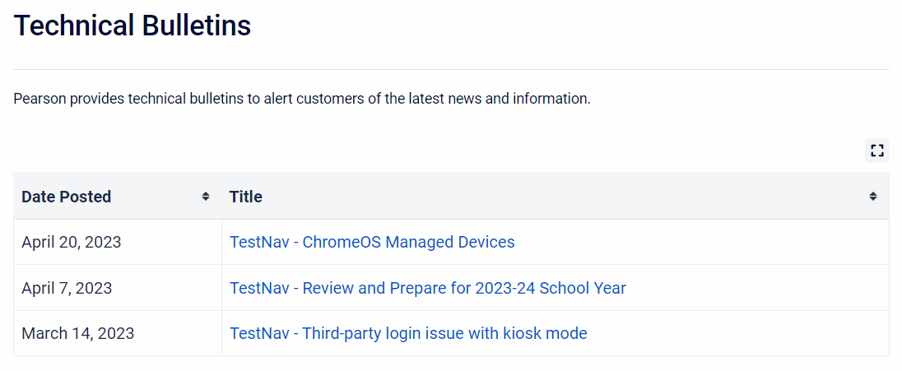
Changes to Technical Requirements
Technical Bulletins

Slide 6
TestNav - Prepare for 2023-2024 School Year
The TestNav - Review and Prepare for 2023-24 School Year communication was developed to help Technology Coordinators prepare for and administer the 2024 NJSLA and NJGPA.
Reminder for Chromebook Setup:
Ensure your testing devices’ operating systems (OS) are using Stable or Long-term support (LTS) channels through the duration of the test administration window (infrastructure trial through end-of-testing).
Do not use Beta or Dev channels. Leaving testing devices on a Beta or Dev Channel could lead to unexpected or disruptive system behavior during testing.
Visit Managing Chrome OS Updates article for more information about how to switch between Stable, LTS, Beta and Dev software channels.

Slide 7
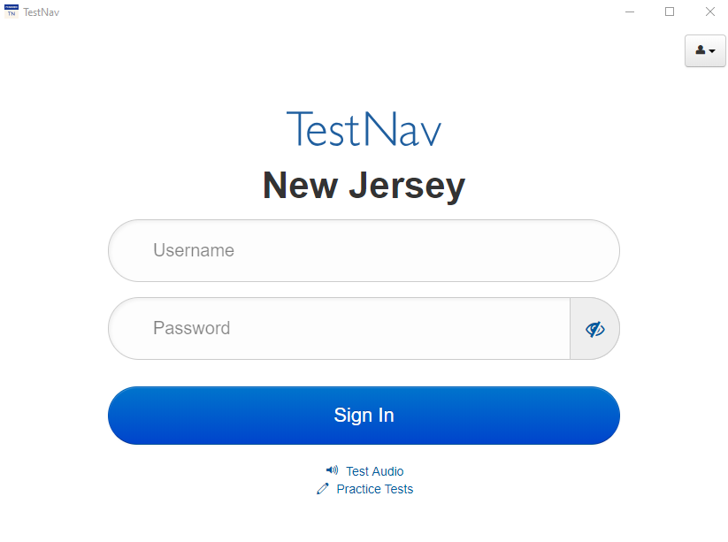
TestNav Overview (1 of 3)
TestNav is an installable test client that:
Is supported on ChromeOS, MacOS, iOS, Linux and Windows devices.
Requires minimal setup and configuration.

Slide 8
TestNav Overview (2 of 3)
Identical student login experience on all testing devices.
Compatible with touchscreen devices.
For supported operating systems, review TestNav System Requirements.
The TestNav Desktop App is compatible with Assistive Technology (AT).
Always test for AT compatibility by completing an Infrastructure Trial.
Review the Assistive Technology Guidelines located on the New Jersey Assessment Resource Center located under Educator Resources > Test Administration Resources > Accessibility Features and Accommodations (AF&A) Resources

Slide 9
TestNav Overview (3 of 3)
Do not make unnecessary changes to the technology environment after preparations for testing are complete.
Confirm that all applications other than TestNav are closed or disabled on the student testing device on days of testing.
TestNav automatically blocks students from logging in when the software detects that other applications are running on the testing device.
Some background applications running on desktop virtualization/thin client technology may prevent TestNav from opening. Prior to student testing, consider comparing the performance between virtual and non-virtual environments.

Slide 10
Proctor Cache
Proctor caching and secondary save locations are no longer recommended for most organizations.
Districts and schools should complete an infrastructure trial.
If the district or school has any issues while completing the infrastructure trial, they should contact Pearson Customer Support for assistance.

Slide 11
Infrastructure Trial (1 of 3)
Infrastructure trial may begin on February 12, 2024 through the PearsonAccess^{next} Training Site.
Review the Infrastructure Trial Guide located on the New Jersey Assessment Resource Center located under Technology Setup > User Guides.
Run a Preliminary System Check:
The Preliminary System Test is an informal, small‐scale Infrastructure Trial and is recommended to help ensure systems are set up and in place before students participate.
Run App Check on all testing devices. View the Run App Check section on each operating system for Step-by-step Installation Setup Instructions.
Have a small number of staff log in to TestNav as students on student devices and click through secure practice tests.

Slide 12
Infrastructure Trial (2 of 3)
When planning for and administering the Infrastructure Trial, keep the following in mind:
It takes approximately 60 minutes to administer after setup.
Ensure student devices meet the system requirements for TestNav.
Ensure students are able to access and log into TestNav.
Ensure test administrators are able to:
Login to PAN Training.
Track progress of tests.
Lock and unlock test units.

Slide 13
Infrastructure Trial (3 of 3)
Occasionally technology concerns that stemmed from locally controlled configurations have been reported during past administrations. These concerns may have been identified and resolved prior to the start of testing had an infrastructure trial had been performed.
Technology Coordinators may schedule time with the Field Services Engineering support specialists before testing for questions on technology setup, TestNav, proctor caching, configurations, and infrastructure trials. To schedule office hours, log into PAN and select the “Schedule Technical Assistance” option on the PAN home screen.
Note: The “Schedule Technical Assistance” option is for technical troubleshooting and questions regarding technology setup and support. This should not be used for support of data files or other platform questions.

Slide 14
Practice Tests
Practice Tests (TestNav Login Required) | Standalone Practice Tests (No Login Required) | Tutorials
Students will be able to: Use the TestNav App to login with Student Testing Tickets printed from the PearsonAccess^{next} Training Site. Experience a simulation of live testing with test administrators. | Students will be able to: Access the practice tests through the TestNav App or online at the Practice Tests webpage. Practice with multiple test units. Familiarize themselves with the kinds of items and format used for the tests. | Students will be able to: Access tutorials through the TestNav App or online at Tutorials webpage. Learn about and interact with the online platform and tools available for Computer-Based Assessments.
Note: The paper-based practice tests have an answer document available to record the student’s answers. However, students taking paper-based assessments will record their answers in the test booklet when they take the NJSLA or NJGPA.

Slide 15
PearsonAccess^{next} Overview and User Accounts

Slide 16
PearsonAccess^{next} (1 of 2)
PearsonAccess^{next} (PAN) is:
An online portal used for the registration, setup, preparation, and management of the administration.
A secure site that requires a username and password.
PearsonAccess^{next} (PAN) consists of:
PearsonAccess^{next} Live Site which is a site for statewide testing available at https://nj.pearsonaccessnext.com/.
PearsonAccess^{next} Training Site which is a site for infrastructure trial and practice testing available at https://trng-nj.pearsonaccessnext.com/.

Slide 17
PearsonAccess^{next} (2 of 2)
Within PAN, test administrations will appear as a scope:
NJSLA/NJGPA-ELA/Math Spring 2024.
NJSLA-Science Spring 2024.
Make sure you have the correct scope selected when working within PAN.

Slide 18
User Management (1 of 6)
PAN user accounts need to be provided for staff who will administer the test, review student results, and/or need to make updates in PAN. Resources to help with this process are available in the following locations:
PAN, located under Support > Documentation section:
User File Field Definitions – gives details about the user account data fields.
User Role Matrix – gives information about user roles.
PAN Online Support – provides step-by-step instructions for creating and managing user accounts.

Slide 19
User Management (2 of 6)
User Roles: PAN users must be assigned roles. Roles are named according to the level of support a user provides (for example, District Test Coordinator, School Test Coordinator, etc.).
Conferrability: Defines the list of roles that a user can grant, or confer, to another user account during user account management.
Permissions: Each User Role includes permissions that determine which tasks that specific User Role can perform in PAN. Permissions are not assigned directly or individually to user accounts, rather, permissions are bundled into User Roles.

Slide 20
User Management (3 of 6)
User Account
- User Name
- Single Password
- Email and Name
PearsonAccess^{next} Live Site
- Active Dates
- Disable Flag & Reason
PARCC Account Scope
- Roles
- Organizations
New Jersey Account Scope
- Roles
- Organizations
PearsonAccess^{next} Training Site
- Active Dates
- Disable Flag & Reason
- Roles
- Organizations
Core-Level Data
Site-Level Data
Account Scope-Level Data
One user account can be granted access to the PAN Live Site and the PAN Training Site.
User ID and Password are the same for both PAN sites.
Configuration of each user account is independently managed in each site. For example, a user account can be granted access to one site, but not the other. If you are responsible for creating user accounts, you may consider configuring account access at the same time for both sites.

Slide 21
User Management (4 of 6)
Current/future administrations appear under the New Jersey Account Scope, and past administrations appear under the PARCC Account Scope in the PAN Live Site.
Users’ role and organization assignments are independently managed under each scope. Users do not have access to an account scope if role and/or organization assignments are blank under the scope. Active Dates and the Disable Flag remain at the PAN site-level.

Slide 22
User Management (5 of 6)
Passwords auto-expire every 180 days. If a user’s password is expired, they can self-initiate a password reset.
A disable flag is automatically added after 240 days from the last day there was activity on the account. If a user's account is disabled, an administrative user will need to remove the disable flag before access is restored to the user.
A delete flag is automatically added after 999 days from the last day there was activity on the account.
Note: Activity on the account could be either the user logs into the site or an administrative user (DTC and/or STC roles) updates the user account (add/remove roles/organizations or updates feature dates).

Slide 23
User Management (6 of 6)
Users default to the last administration scope they worked under or had their account updated under.
Create accounts for new staff members and verify existing user accounts are assigned the appropriate roles.
Check restrictive fields such as the Active Begin Date, Active End Date, and Disable Flag are updated to ensure users can log into PAN.
User accounts can be created or updated through the PAN user interface or by importing a User File.
Please note that the Test Administrator role is restrictive and will prevent users who are also assigned the DTC or Report Access roles from viewing all On-Demand Type Reports.
If a user’s email address changes, a new PAN user account should be created for them and the old PAN user account disabled. It is best practice to have the username match the email address.

Slide 24
Student Data Management

Slide 25
Student Data Structure in PAN
Core-level Student Data
First Name, Last Name, Date of Birth, etc.
Non Administration -specific
Administration-level Data
Demographic Information, Race/Ethnicity, etc.
Enrollment
Administration-specific
Test-level Data
Test, PNP, etc.
Administration-specific

Slide 26
Administration Scopes in PAN
Two Administration Scopes for Spring 2024
NJSLA/NJGPA - ELA/Math Spring 2024
One administration scope for two testing windows.
Manage NJSLA-ELA/M and NJGPA under one administration.
Review the Spring 2024 Administration Key Dates available on the NJSLA/NJGPA Resources for Districts webpage for different deadlines/windows for each administration.
NJSLA - Science Spring 2024

Slide 27
Student Data
Data submitted to NJ SMART by December 5, 2023 will be uploaded into PAN by NJDOE.
Starting on January 23, 2024, Districts/Schools will have the ability to update Student Registration in PAN.
Enrollment counts used to calculate materials quantities for the NJSLA initial distribution will be locked on March 8, 2024. Student Registration can be updated up to the end of the testing windows*.
*Note: Refer to the key dates document for different windows by administration. View Spring 2024 Administration Key Dates available on the NJSLA/NJGPA Resources for Districts webpage for different deadlines/windows for each administration.

Slide 28
Paper Testing
Answer documents are no longer used for paper-based testing. Instead, students write their answers in their test booklet. All student responses recorded in the student’s paper test booklet must be transcribed into TestNav based on the NJSLA/NJGPA Accommodated Paper-Tests Procedures guidance document available at the New Jersey Assessments Resource Center, located under Educator Resources > Test Administration Resources > Testing Resources.
A few items to note:
Student test format must be set to Online. Districts may need to review their student data information systems and update valid values for this field.
Districts must set up a “Transcription English,” “Transcription Spanish,” or “Transcription Braille” test session and add the test registrations.
Students that do not have responses transcribed into TestNav by the established deadline will not receive a valid scale score.

Slide 29
Student Data Management in PAN – Paper Testing (1 of 3)
Students must be registered with Test Format set as Online and the following fields populated based on the specific paper accommodation type needed. See the table below for information regarding PNP field requirements for each paper-based testing format.
Paper Testing Format | PNP Field Requirement(s)
Paper | Test Format = O (Online) Alternate Representation - Paper Test = Y
Large Print | Test Format = O (Online) Alternate Representation - Paper Test = Y Large Print = Y
Human Reader/Signer | Test Format = O (Online) Alternate Representation - Paper Test = Y Human Reader or Human Signer = 01 - Human Signer or 02 - Human Read Aloud
Braille | Test Format = O (Online) Alternate Representation - Paper Test = Y Braille with Tactile Graphics = Y

Slide 30
Student Data Management in PAN – Paper Testing (2 of 3)
Paper Testing Format | PNP Field Requirement(s)
Spanish Paper | Test Format = O (Online) Alternate Representation - Paper Test = Y Spanish Transadaptation = SPA
Spanish Large Print | Test Format = O (Online) Alternate Representation - Paper Test = Y Large Print = Y Spanish Transadaptation = SPA
Spanish Human Reader/Signer | Test Format = O (Online) Alternate Representation - Paper Test = Y Spanish Transadaptation = SPA Human Reader or Human Signer = 01 - Human Signer or 02 - Human Read Aloud
For more details about registering students, refer to the Student Registration/Personal Needs Profile (SR/PNP) Field Definitions Document, available under Support > Documentation in PAN.

Slide 31
Student Data Management in PAN – Paper Testing (3 of 3)
Districts must set up a “Transcription English,” “Transcription Spanish,” or “Transcription Braille” test session and transcribe these student responses directly into TestNav by the established deadline.
View the NJSLA/NJGPA Accommodated Paper-Tests Procedures for additional information.
Districts will no longer return a scorable shipment to the vendor. Headers and scorable return labels are no longer provided. All secure materials, including consumed test booklets, will now be returned as part of a single nonscorable shipment.
Student responses must be transcribed from test booklets into TestNav by the established deadline before returning secure material to vendors.

Slide 32
Materials
Enrollment counts used to calculate materials quantities for the NJSLA initial distributions will be locked on March 8, 2024. Additional orders will need to be placed for materials not included in the initial shipment beginning on April 15, 2024.
NJGPA will not have an initial distribution. All materials will need to be requested through additional orders, between February 19 and March 15, 2024.
The additional order window within the NJSLA/NJGPA-ELA/Math administration scope will be open at two different times (first for NJGPA materials and then later for NJSLA materials).
Braille test kits are no longer automatically shipped for students whose SR/PNP indicates the screen reader accommodation.

Slide 33
Student Data Management: Making Updates
User Interface
Can be used to make updates before, during, and after testing.
Quickest way to update records.
Limitations to making updates (Accountable Organizations).
Pro Tip: Export SR/PNPs and STU Files to provide a snapshot in time of student data. This can be used to reference or to revert changes, should the need arise.

Slide 34
Student Data Management: SR/PNP
Student Registration/Personal Needs Profile (SR/PNP)
Used to create or update student records en masse including core student data, enrollment, registration data, and test data.
Used to make updates before and during testing.
Start from the template located on the Secure Support Page of PAN or from an exported SR/PNP.
Note: The SR/PNP Field Definitions document can be located on the Secure Support Page of PAN.

Slide 35
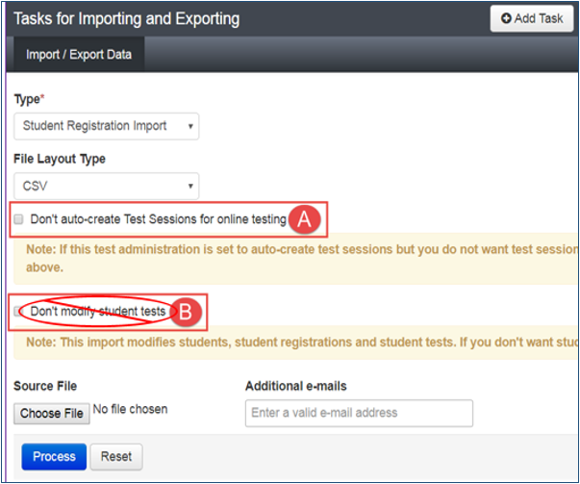
Student Data Management: SR/PNP Import
Use Don’t auto-create Test Sessions for online testing option to not auto-create test sessions when importing an SR/PNP.
Leaving option blank – Test Sessions are auto-created/tests auto-added to sessions if Session Name field is populated and tests aren’t currently assigned to a session.
Check option – Test sessions are not auto-created and tests are not auto-added to sessions.
Do not select Don’t modify student tests. This option should only be selected when updating existing student demographic data without updating test registration data.
Leaving option blank – PAN reads/updates Core-, Administration-, and Test-level data.
Check option – PAN reads/updates only Core-, and Administration-level data. Test-level data is ignored. Will result with students being enrolled and registered to an administration, but no tests being assigned (or updated).

Slide 36
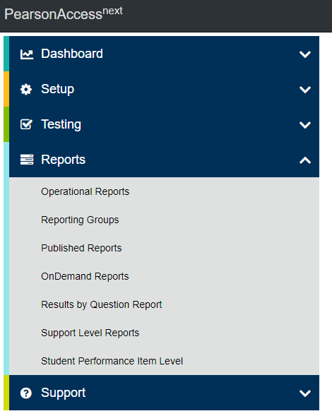
Operational Reports
Operational reports within PAN detail data gathered on operations before, during, and after testing to help with necessary assessment tasks.
Operational Report Types include:
Online Test Session Reports
Orders and Shipment Tracking Reports
Organizational Reports
Student and Registration Reports
User Reports

Slide 37
Verify Student Registration
Run the Students Enrolled but not Registered for Test Administration operational report to identify students that may need to be registered to the administration and assigned tests.
Run the Students Registered but not Assigned to a Test operational report to identify students that may need to have tests assigned.
These reports can be located on the Operational Report Screen under Report Categories by choosing Students & Registrations.

Slide 38
Verify PNP Assignment
Run the PNP Report – Accessibility Features and Accommodations for Student Tests operational report to help verify students are assigned the appropriate accommodations and accessibility features.
It is very important to verify PNP data is captured correctly within PAN prior to preparing online test sessions as this is when forms are assigned to students.
Run the Students with Disability with No Accommodation operational report to identify students that have an Individualized Education Program (IEP) and/or 504 plan but do not have any accommodation(s) captured.
These reports can be located on the Operational Report Screen under Report Categories by choosing Students & Registrations.
Accommodation Reminders appear for certain PNP accommodations. Tests without proper documentation may result in the student’s test being invalidated.

Slide 39
Student Data Management: PNP Updates
Correct Session Assignments or PNP Data
Use the Student Registration Delete File to start from a clean slate. This may be needed for the following:
Update session assignments: importing an updated SR/PNP alone will not move or remove student tests from current session assignments. Import a Student Registration Delete File to wipe out current session assignments and then proceed with importing a new SR/PNP.
Students are assigned specific test forms based on their PNP when sessions are prepared. Therefore, a Student Registration Delete File can be used to remove form assignments for unconsumed student tests that are in prepared or started sessions.
Note: A Student Registration Delete File will not remove partially consumed or completed tests.

Slide 40
Student Data Management: Transfers (1 of 2)
Follow the process steps outlined in the Transfer Student (CBT) Guidance available at the New Jersey Assessments Resource Center located under Educator Resources > Test Administration Resources > PearsonAccess^{next} Resources.
Start with the following:
If a student has transferred into your district, first try to register a student before requesting a transfer work request. The student may have already be unregistered from their previous school.
If a student has transferred out of your district, check for transfer requests before trying to un-register students.

Slide 41
Student Data Management: Transfers (2 of 2)
Students’ accountable organization is automatically updated to the new testing organization the student transfers to.
A student online test assigned to a test session under the transfer from organization will be automatically moved to a holding transfer session at the new transfer to organization.
Student tests not assigned to a session under the transfer from organization will need to be placed into a session at the new transfer to organization.

Slide 42
Online Test Management

Slide 43
Online Test Management Overview
Set up and/or review test sessions in PearsonAccess^{next}.
Print student testing tickets and store in a secure place.
Confirm form assignments and PNPs are correct.
Ensure students are in the correct testing sessions, including students requiring human reader test sessions.
Prepare sessions.
Start sessions.
Unlock units.
Monitor test progress.

Slide 44
Test Management
Due to administering NJGPA and NJSLA-ELA/M under one administration scope within PAN, certain functionality may appear to open up early for NJSLA-ELA/M (e.g., preparing sessions).
Users will receive an error if trying to prepare NJSLA sessions before April 24, 2024.

Slide 45
Online Test Management: Session Setup (1 of 2)
A session is a virtual student group that will test at the same time.
Sessions can be auto-created from a SR/PNP import or manually created through the user interface.
Recommended naming convention for a session is: ContentArea-Grade-TestAdministrationLastName-RoomNumber-AMorPM-ExtendedTime-IEP-504-MultilingualLearnerAccommodation.

Slide 46
Online Test Management: Session Setup (2 of 2)
Students needing a Human Reader/Human Signer must be placed into sessions that have been set up as human reader/human signer.
This is done so all students within the session are assigned the same test form, and it enables test administrators to download a Proctor Authorization Form with can be used to log into TestNav and read the test to students.
Sessions will need the “From Group Type” field manually switched to Human Reader or Human Reader Spanish (Mathematics only) under Edit Sessions screen in PAN.
Print Proctor Authorization Tickets: Similar to a student testing ticket, these tickets allow a test administrator to access secure test content in TestNav to read or sign to students.
Note: Students using a paper version of the Read Aloud test kit should have their tests placed into sessions with the “Form Group Type” field setup for “Transcription English” (or “Transcription Spanish” if using a Spanish Read Aloud Test Kit).

Slide 47
Online Test Management: Sessions
There are two options to move students to different test sessions:
Option 1: Users can manually move students to different sessions through the user interface.
Option 2: Users can remove students from the current test sessions (manually or by importing a Student Registration Delete File) and then import the SR/PNP with updated Session Name field values.
If students are currently assigned to a test session, then updating the Session Name field and re-importing the SR/PNP will not move students to new sessions or update the current session name.
The SR/PNP can be used to add students to existing sessions.
Test tickets will need to be reprinted if student session assignment changes.

Slide 48
Online Test Management: Print Test Tickets
The Print Test Tickets for multiple sessions features allows print of test tickets for multiple sessions as a time. Use the following steps for generating test tickets:
Within PAN, navigate to Testing > Sessions.
Select the session records.
Under Tasks, select Generate Test Tickets and select Start.
On the Generate Test Tickets task screen, select Generate Test Tickets icon and then select the desired format (1 per page, grid, or list).
A banner page separates tickets between sessions.
For performance reasons, this feature is limited to a selection of 4,000 or fewer students total assigned across the selected sessions.
Notes:
.

Slide 49
Online Test Management: Print All Test Tickets for a Student
The Print All Test Tickets for a Student feature adds the ability to print testing tickets for all tests across sessions for a single student. Use the following steps for generating test tickets:
Within PAN, navigate to Setup > Students.
Search and select the info icon for the student record.
Select the Sessions tab.
Select Print Student Testing Tickets.

Slide 50
Online Test Management: Operational Reports
Run the Students with Online Test but not assigned to Session operational report to identify online tests that need to be placed in test sessions.
Run the Students Currently Testing Online operational report to identify students that have started a test but have not completed all units.
Run the Session Roster operational report to view students' testing progress.
These reports can be located on the Operational Report Screen under Report Categories by choosing Online Testing.

Slide 51
Online Test Management: Accommodation Indicators
A marker appears next to the Student ID on the Students in Session screen if an accommodation was identified for a student record on the Manage Student Test Screen or through the SR/PNP import.
These forms are independent forms and cannot be combined.
Use these indicators to identify error in accommodation settings.
Prior to testing day, districts should review the markers next to students’ tests to ensure they were provided the correct accommodated form.
Indicator | Accommodation
ASL | American Sign Language
SR | Assistive Technology- Screen Reader
Non-SR | Assistive Technology- Non-Screen Reader
CC | Closed Captioning
TTS | Text-to-Speech
STTS | Spanish Test-to-Speech
S | Spanish

Slide 52
Online Test Management: Session Statuses
Not Prepared: Initial status of a session, when a session is created.
Preparing: A session is in queue for form assignment.
Ready: Session has been prepared and all forms have been assigned to the session.
In Progress: Session has been started and students are testing.
Stopped: All testing is complete, and students cannot be added to the session.
Errors – Not Prepared: Contact Pearson Support for assistance.

Slide 53
Online Test Management: Prepare Sessions
This step should be completed one school day prior to starting a test session.
This step will assign forms to each student in the test session.
Prior to completing this step, ensure that the appropriate accommodations are assigned to students.
If accommodations are not accurately indicated prior to this step, the student will need to be removed from the test session, have their PNP updated, and then be added back to the test session to reset form assignments.
Once this step is completed, and the testing window is open, the test session can be started.
This can only be done by users assigned the District Test Coordinator (DTC) or School Test Coordinator (STC) roles.

Slide 54
Online Test Management: Start Sessions
A session must be started, a test unit unlocked, and a student provided a testing ticket with TestNav login credentials before students can take their tests.
Starting a session can be done at any time before testing once the testing window is open and the session had been prepared.

Slide 55
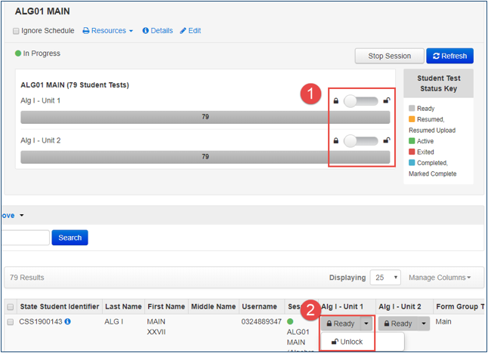
Online Test Management: Unlock Units
Units can be:
Unlocked for all students in the session.
Individually unlocked.
Test units that are not consumed on the planned day of testing must be re-locked until make-up testing is to start.
Test units that have been completed do not need to be locked. Only the unit being tested must be unlocked for a student.
Only one unit at a time can be unlocked for each student’s test.
For more information, refer to the Manage Students in Sessions training module available on the PearsonAccess^{next} User Guide.

Slide 56
Online Test Management: Test Unit Statuses
Ready: The student has not yet started the unit.
Active: The student has logged in and started the unit.
Exited: The student has exited TestNav but has not submitted test responses. (Student cannot resume testing unless authorized by TA.)
Resumed: The student has been authorized to resume the unit. Resume a unit when a student exits a unit (either intentionally or unintentionally) before finishing the unit and you want the student to continue the same unit. Students in Ready, Completed, or Marked Complete statuses cannot be resumed.
Resume Upload: Resume Upload should only be used in rare circumstances when TestNav cannot locate the Saved Response File (SRF) and an error code appears on the student testing device. Resume Upload prompts TestNav to check for a SRF on the testing computer when the student signs in to continue.
Completed: The unit has been submitted by the student through TestNav and has been processed.
Marked Complete: The TA or STC marked a unit complete when a student had exited TestNav and did not return to submit the unit on their own.

Slide 57
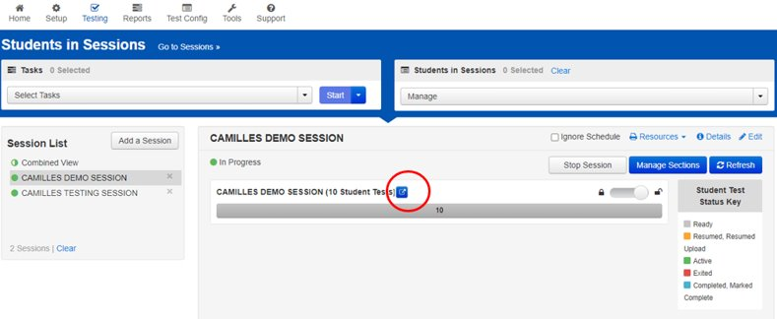
Online Test Management: Monitor Progress
Monitoring Students in Session using a session dashboard.
Allows the ability to monitor students while testing.
Users will have the ability to see login status, test progress, and duration.
Access using the pop-out link and the dashboard will open in a new tab.

Slide 58
Online Test Management: Student Test Monitoring Dashboard (1 of 2)
Test Status: Indicates if the test is Ready, Active, Complete or Exited.
Test Duration: Is calculated based on the student starting the test and stopping or submitting.
Battery: Shows the life of the battery on the student’s testing device.
Test Progress: Indicates the status of test questions.

Slide 59
Online Test Management: Student Test Monitoring Dashboard (2 of 2)
Use the Refresh button to refresh students' testing status per updates from TestNav.
Refreshing is not automatic.
After selecting Refresh, the button will be disabled for 30 seconds to prevent performance issues.

Slide 60
Online Test Management: Make-up Sessions
Students may need to be moved into a new make-up test session in PAN (e.g., if they are absent or become ill while taking a test). However, if the student will rejoin the regular administration for any remaining units, it is recommended to leave that student in the original test session in PAN.
If moving students to a new session, be sure to print new Student Authorization Tickets. TestNav login information will change when students are moved between sessions.
Make-up test sessions must reflect the original test session (e.g., A test session with a human reader will need a make-up test session with a human reader.).
For more information, refer to Manage Students in Sessions training module available on the PearsonAccess^{next} User Guide.

Slide 61
Online Test Management: Troubleshooting
Use the following steps for a student that experienced a technology issue during testing:
Resume the student in PAN.
Have the student log in again on the same testing device. Tests will automatically resume at the exact point where a student exited.
If the same error occurs repeatedly, or if the same error is affecting multiple students, contact your Technology Coordinator.
Do not move the student to another testing device unless the student safely exits the test using the log out feature. This is to help prevent student responses from becoming more difficult to retrieve.
View TestNav Troubleshooting Resources.
If troubleshooting does not resolve the issue, the Technology Coordinator, DTC, or STC must immediately call the Customer Support Center at 1-888-705-9416 and NJDOE to report the issue.

Slide 62
Post-Test Management

Slide 63
Post-Test Management Overview
Remove or move unconsumed tests from prepared/started sessions.
Mark tests complete.
Stop sessions.
Confirm accountable organizations.
Input Not Tested, Void Flags, and Reason Codes.
Resolve Critical Warnings.

Slide 64
Remove Unconsumed Tests from Sessions
After testing, all partially consumed tests must be marked complete. Started and prepared sessions must be stopped. Prior to doing these tasks, make sure to do the following:
Remove unconsumed tests (tests with all units in a ready status) from the session.
These tests can also be moved to un-prepared sessions. Some districts label these sessions as “not tested.”
Important: If students were registered for a test in error, refer to the Section 5.3 of the Test Coordinator Manual for steps to unassign tests and/or unenroll students in error.
Test sessions cannot be stopped unless all tests in the session are in a complete/marked complete status.
Note: Tests that have not been logged into by the student (all units in a ready status) cannot be marked complete. Instead, they must be removed/moved from the session and have a Not Tested flag and code applied.

Slide 65
Mark Tests Complete
Test units must be marked complete for students who exited the test and did not resume testing, or who exited a test instead of clicking Submit.
Student tests are not submitted for scoring until all units are in a Complete or Marked Complete status.
A reason that the test is being Marked Complete must be entered in PAN.
If one or more units has a status other than Ready, then all units of the test must be marked complete.
To identify tests that should be marked complete, view the Students Currently Testing Online operational report.
Student tests in transfer sessions will need to be moved to a started session in order to mark them complete. Transfer sessions cannot be prepared or started.
Partially consumed tests may be moved to sessions that haven’t been prepared or started. The session will need to be prepared and started or the test moved to a started session in order to mark the test complete.

Slide 66
Stop Sessions
Test sessions cannot be stopped until all student tests are in Completed or Marked Complete status.
Complete this as soon as your district’s testing window has closed.
Once you have completed testing, the DTC must complete the Post-Test Certification Form for each school in the district and upload them to PAN.

Slide 67
Student Data Management: STU Import
Student Test Update File (STU)
Used to update student records en masse including core student data, registration data, and test data.
Used to make updates after testing.
Always start from an exported STU File found under Setup > Import/Export Data screen in PAN.
Note: The STU File Field Definitions Document can be located on the Secure Support Page of PAN.

Slide 68
Online Test Management: Accountable Organization
Verify students’ accountable organization is correct, especially in the case where the student’s accountable organization is not the same as their testing organization.
Assigning incorrect accountable district/school information to students will result in inaccurate district and school summary data, which may have a serious impact on district/school performance and accountability reports.
When a student enrollment transfer work request is approved, the accountable organization will automatically be updated to the new testing organization the student is transferring to.
Students attending a charter school or full-time vocational-technical school, regardless of the school’s location, are not considered out-of-district or in-district placements. Charter schools and full-time vocational-technical schools are the accountable district and school.

Slide 69
Operational Reports: Verify Accountable Organizations (1 of 3)
There are two operational reports to assist with verifying students have the correct accountable organization captured.
Students where Accountable District/School is different from Testing District/School.
(For Accountable Organization) Students where Accountable District/School is different from Testing District/School.
These reports can be located on the Operational Report Screen under Report Categories by choosing Students & Registrations.

Slide 70
Operational Reports: Verify Accountable Organizations (2 of 3)
The operational report Students where Accountable District/School is different from Testing District/School is at the testing organization level and should be run by both accountable districts and testing districts.
This report identifies students for which the organization is the testing but not the accountable organization.
Districts/schools are expected to confirm the information in this report is correct. Any incorrect information must be changed in the student's record.

Slide 71
Operational Reports: Verify Accountable Organizations (3 of 3)
The operational report (For Accountable Organization) Students where Accountable District/School is different from Testing District/School is at the accountable organization level.
This report identifies students for which the accountable organization is listed as accountable, but not testing.
Districts/schools are expected to confirm the information in this report is correct. If any incorrect information is discovered, the testing district/school is to be contacted to correct the student's accountable organization.

Slide 72
Operational Report: Resolve Duplicate Valid Attempts within a Content Area
The system will not allow for multiple valid attempts for the same test code due to new Void Flag validation.​ Note: This does not apply to a student who takes a NJGPA and NJSLA for mathematics.
Run the Students with Multiple Tests operational report to identify students that may have more than one test in a content area (e.g., student with a valid Geometry and Algebra I test).​ This report can be located under Students & Registration Report Categories on the Operational Report Screen.
One test may need to be voided to address this issue.

Slide 73
Student Data Management: Not Tested Flag
Not Tested Codes are to be used when a student has never logged into TestNav. The Not Tested Reasons are:
01 - Absent
02 - Medical emergency
03 - Other (refusal)
Not Tested Codes can only be applied to student tests that are in Assigned status. Completed tests must have Not Tested codes removed.

Slide 74
Student Data Management: Void Test Flag
Void Codes are to be used when a student has logged into TestNav but did not complete testing. A validation rule will require users to void a test before a second test can be assigned for the same grade/subject. The Void Test Score Reasons are:
01 - Student Cheating
02 - Security Breach
03 - Other (refusal, wrong form, off-grade level, off-course, accommodation/ accessibility feature provided or not provided in error)

Slide 75
Resolve Critical Warnings
Critical warnings appear when students have missing demographic data.
If the flag at the top of the page is red, there may be students with warnings and errors that must be resolved before the test administration closes.​
Click on the warning or errors to go to the Students page.
Select the students who have warnings and use the Register Students task to view/resolve.

Slide 76
Thank You!
Office of Assessments Website
assessment@doe.nj.gov
Pearson's technical support team is available to support districts prior to, during, and after the assessment administration window. District Test and Technology Coordinators may contact the NJSLA/NJGPA helpdesk at any time for support.
Pearson Customer Support
(888) 705-9416
Follow Us!
Facebook: @njdeptofed
Twitter: @NewJerseyDOE
Instagram: @NewJerseyDoe

